Slide 1
Coalition PSP Goals and Metrics
Plan Years 2024 – 2027

Slide 2
Overview
The Performance Sharing Program (PSP) is part of the 2023 Coalition National Agreement negotiated between Kaiser Permanente and the Coalition of Kaiser Permanente Unions.
Overall PSP goals and performance improvement metrics are jointly set for the entire 4 years of the national agreement, which ends September 30, 2027.
Use this slide deck, packed with tips and tools, to help your team understand PSP goals and metrics for plan years 2024 to 2027.

Slide 3
Controlling High Blood Pressure
Description
The percentage of Kaiser Permanente members, 18-85 years of age of the 4 largest racial/ethnic populations, who had a diagnosis of hypertension and whose blood pressure was adequately controlled (<140/90), according to the HEDIS data set, “Controlling High Blood Pressure.”
Performance Period
12 months ending September 30
Goal Improvement
2%
Data Source
HEDIS

Slide 4
Controlling High Blood Pressure
 |  | ANNUAL TARGETS
Region | 2023 Baseline | 2024 | 2025 | 2026 | 2027
Colorado | 77.13% | 77.70% | 77.70% | 77.70% | 77.70%
Hawaii | 69.40% | 71.40% | 73.40% | 75.40% | 77.40%
Mid-Atlantic States | 79.73% | 79.73% | 79.73% | 79.73% | 79.73%
Northern California | 74.78% | 76.78% | 77.70% | 77.70% | 77.70%
Northwest | 66.25% | 68.25% | 70.25% | 72.25% | 74.25%
Southern California | 80.18% | 80.18% | 80.18% | 80.18% | 80.18%
Washington | 63.68% | 65.68% | 67.68% | 69.68% | 71.68%

Slide 5
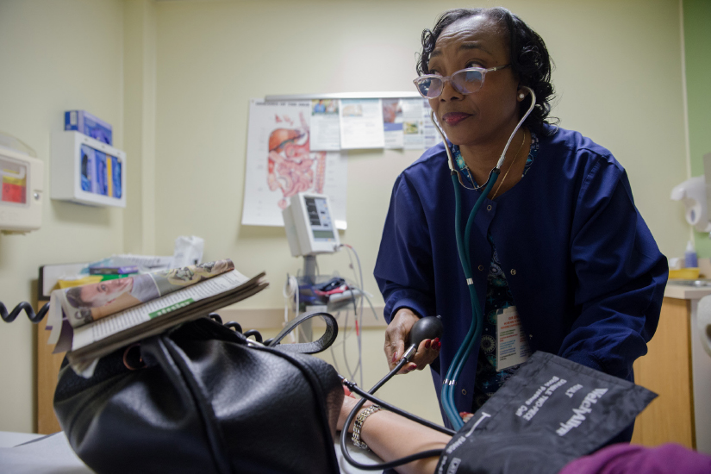
Controlling High Blood Pressure
Why this goal is important:
Hypertension is a serious health problem that can lead to heart failure or heart attack. By helping patients manage their blood pressure, we’re helping them stay healthy and thrive.
Get inspired.
See how this adult primary care team helped patients control their high blood pressure by focusing on those at highest risk.

Slide 6
Flu Vaccination
Description
Percent of Kaiser Permanente members, older than 6 months of age without a medical history exclusion, with a record of receiving flu vaccines via Kaiser Permanente, outside pharmacy or medical claims, Care Everywhere Data, or patient reported.
Performance Period
August to December
Goal Improvement
1.5%
Data Source
Pharmacy Dashboard

Slide 7
Flu Vaccination
Full Goal Description
Daily Count of Flu Vaccine Administrations (Numerator) | Member exists in the denominator
 | Member has at least one records of the following in the August to December time periods
 | KP Internal vaccines documented in KPHC as administered (sourced via Clarity)
 | Network vaccines documented in either: a. Pharmacy claims from network pharmacies (sourced from PBM data) b. Medical Claims (sourced from Claims Data Warehouse)
 | Patient reported vaccines documented manually in KPHC or via an external interface into KPHC (sourced via Clarity)
 | Care Everywhere data documented in KPHC (sourced via Clarity)
Active Membership Count (Denominator) | Continuous membership through the influenza vaccine season (August to December)
 | Age > 6 months
 | Membership sourced through Membership Data Warehouse (MDW)
 | Exclusion: History of anaphylaxis reaction to flu vaccines; History of Guillain Barre Syndrome; KPWA EDS members

Slide 8
Flu Vaccination
 |  | ANNUAL TARGETS
Region | 2023 Baseline | 2024 | 2025 | 2026 | 2027
Colorado | 43.20% | 44.70% | 46.20% | 47.70% | 49.20%
Hawaii | 27.60% | 29.10% | 30.60% | 32.10% | 33.60%
Mid-Atlantic States | 37.50% | 39.00% | 40.50% | 42.00% | 43.50%
Northern California | 36.70% | 38.20% | 39.70% | 41.20% | 42.70%
Northwest | 35.70% | 37.20% | 38.70% | 40.20% | 41.70%
Southern California | 37.50% | 39.00% | 40.50% | 42.00% | 43.50%
Washington | 43.10% | 44.60% | 46.10% | 47.60% | 49.10%

Slide 9
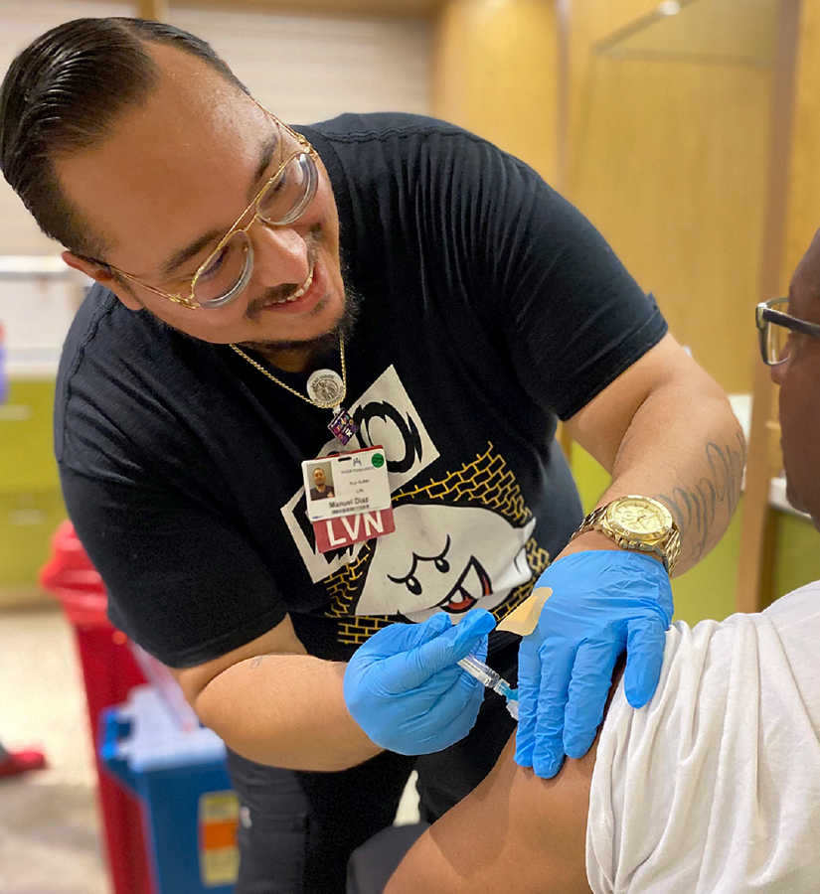
Flu Vaccination
Why this goal is important:
The flu vaccine can lower the risk of getting the flu. It also can reduce the risk of developing serious illness from the flu and needing to stay in the hospital or dying from the flu.
Take action.
Take steps to protect yourself, your family, co-workers, and members and patients from flu and other infectious diseases.

Slide 10
HCAHPS
Description
Top box performance for the question:
“Would you recommend this hospital to your friends and family?”
Performance Period
Q4 to Q3
Goal Improvement
1%
Data Source
KFH Hospital Consumer Assessment of Healthcare Providers and Systems (HCAHPS) survey data, National Care Experience Analytics
Special Note: Service goal is equally split between HCAHPS and CAHPS for hospital regions Northern California, Northwest, Southern California and Hawaii

Slide 11
HCAHPS
 |  | ANNUAL TARGETS
Region | 2023 Baseline | 2024 | 2025 | 2026 | 2027
Colorado | – | – | – | – | –
Hawaii | 77.40% | 78.40% | 79.40% | 80.40% | 81.40%
Mid-Atlantic States | – | – | – | – | –
Northern California | 71.10% | 72.10% | 73.10% | 74.10% | 75.10%
Northwest | 74.10% | 75.10% | 76.10% | 77.10% | 78.10%
Southern California | 75.40% | 76.40% | 77.40% | 78.40% | 79.40%
Washington | – | – | – | – | –

Slide 12
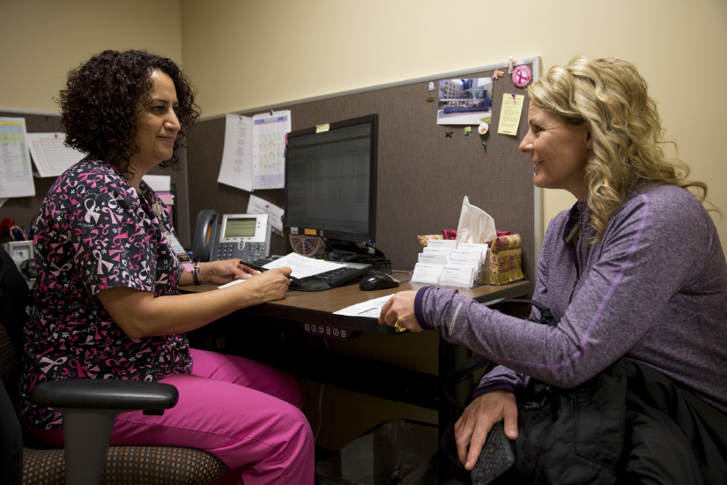
HCAHPS
Why this goal is important:
Members and patients are at the center of everything we do. It’s up to all of us to make sure every patient and member’s experience is convenient, easy, personal, and respectful.
Take action.
Exceed members’ expectations every time with these 3 simple tools.

Slide 13
CAHPS Meteor
Description
The average percent of Kaiser Permanente members who answered “Usually” or “Always” to the 2 Customer Service items around “being treated with courtesy and respect” and “provided the help and information needed.”
Performance Period
Annual (2Q + 4Q) scores
Goal Improvement
2%
Data Source
Consumer Assessment of Healthcare Providers and Systems (CAHPS) survey, as well as the Fall METEOR survey, which replicates the Spring CAHPS but is sent out in the Fall
Special Note: For non-hospital regions, Colorado, Mid-Atlantic States, and Washington, only the CAHPS Meteor goal applies

Slide 14
CAHPS Meteor
 |  | ANNUAL TARGETS
Region | 2023 Baseline | 2024 | 2025 | 2026 | 2027
Colorado | 84% | 86% | 88% | 90% | 92%
Hawaii | 85% | 87% | 89% | 91% | 93%
Mid-Atlantic States | 89% | 91% | 93% | 95% | 97%
Northern California | 85% | 87% | 89% | 91% | 93%
Northwest | 85% | 87% | 89% | 91% | 93%
Southern California | 86% | 88% | 90% | 92% | 94%
Washington | 81% | 83% | 85% | 87% | 89%

Slide 15
CAHPS Meteor
Why this goal is important:
Our mission is to provide high-quality care to the members, patients, and communities we serve. Caring for patients is what we do!
Get inspired.
See how this team in the Mid-Atlantic States Region made new members feel welcome — and raised patient satisfaction scores.

Slide 16
Attendance
Description
The attendance improvement metric includes all absences except vacation, ETO/PTO, holiday, legally protected leaves, unprotected educational leave, unprotected military leave, flexible personal days/life balance days and unprotected union leave.
Performance Period
Pay periods 1 through 26
Goal Improvement
Achieve 2% improvement year over year
Data Source
Common Lost Time Metric (CLTM)

Slide 17
Attendance
 |  | ANNUAL TARGETS
Region | 2023 Baseline | 2024 | 2025 | 2026 | 2027
Colorado | 11.08 | 10.86 | 10.64 | 10.43 | 10.22
Hawaii | 6.35 | 6.22 | 6.10 | 5.98 | 5.86
Mid-Atlantic States | 11.81 | 11.57 | 11.34 | 11.12 | 10.89
Northern California | 20.98 | 20.56 | 20.15 | 19.75 | 19.35
Northwest | 12.80 | 12.54 | 12.29 | 12.05 | 11.81
Southern California | 21.85 | 21.41 | 20.98 | 20.57 | 20.15
Washington | 11.95 | 11.71 | 11.48 | 11.25 | 11.02

Slide 18
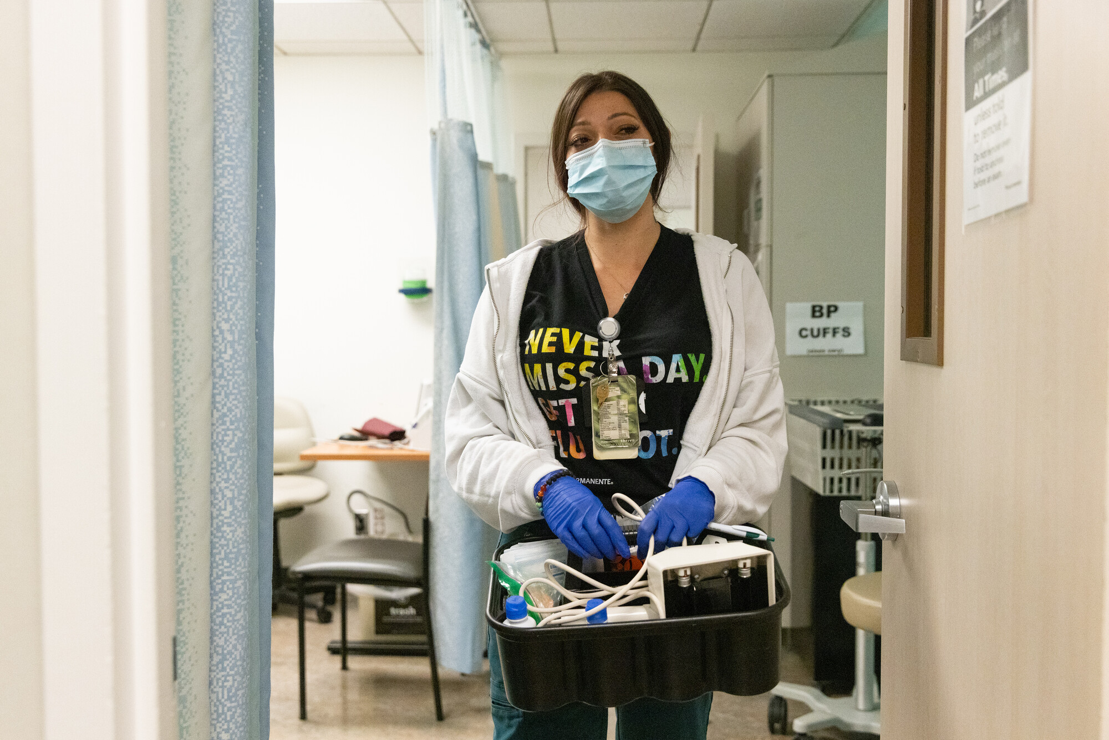
Attendance
Why this goal is important:
Your presence means our patients and members get great care, anytime and anywhere, in the way they want it.
Get inspired.
See how this urgent care team came up with a successful plan to reduce sick calls and combat staff burnout.

Slide 19
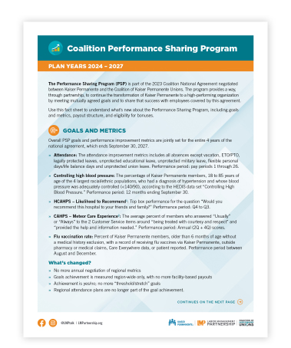
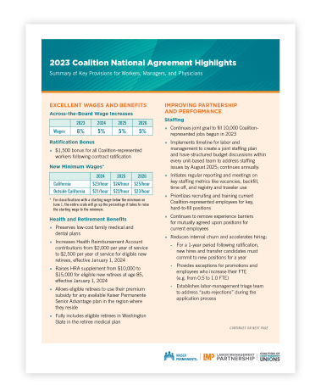
Resources
Find additional resources about the Coalition Performance Sharing Program at LMPartnership.org:
Coalition PSP Factsheet
Understand the goals, metrics, and payout structure for plan years 2024 to 2027
2023 Coalition National Agreement Highlights
Summary of key contract provisions, including the Coalition Performance Sharing Program

