Slide 1
2023 Coalition National Agreement Highlights
SUMMARY OF KEY PROVISIONS FOR WORKERS, MANAGERS, AND PHYSICIANS

Slide 2

2023 Coalition National Agreement
The 4-year Coalition National Agreement covers more than 85,000 health care workers represented by 11 union locals that are part of the Coalition of Kaiser Permanente Unions.
The contract is in effect from October 1, 2023, to September 30, 2027.
The national agreement furthers the goals of the Labor Management Partnership with a focus on:
  Economics
  Staffing
  Performance Sharing Plan
  Education and Training

Slide 3
Excellent Wages and Benefits
Across-the-Board Wage Increases
 | 10/1/23 | 10/1/24 | 10/1/25 | 10/1/26
Wages | 6% | 5% | 5% | 5%
Ratification Bonus
$1,500 one-time bonus for all Coalition-represented workers
following contract ratification
New Minimum Wages*
 | 6/1/24 | 6/1/25 | 6/1/26
California | $23/hour | $24/hour | $25/hour
Regions Outside CA | $21/hour | $22/hour | $23/hour
*For classifications with a starting wage below the minimum on June 1, the entire scale will go up the percentage it takes to raise the starting wage to the minimum.

Slide 4
Health and Retirement Benefits
Preserves low-cost family medical and dental plans
Increases Health Reimbursement Account contributions from $2,000 per year of service to $2,500 per year of service for eligible new retirees, effective January 1, 2024
Raises HRA supplement from $10,000 to $15,000 for eligible new retirees at age 85, effective January 1, 2024
Allows eligible retirees to use their premium subsidy for any available Kaiser Permanente Senior Advantage plan in the region where they reside
Fully includes eligible retirees in Washington State in the retiree medical plan

Slide 5
Staffing
Continues joint goal to fill 10,000 Coalition-represented jobs begun in 2023
Implements timeline for labor and management to create a joint staffing plan and have structured budget discussions within every unit-based team to address staffing issues by August of 2025; continues annually.
Initiates regular reporting and meetings on key staffing metrics like vacancies, backfill, time off, and registry and traveler use
Prioritizes recruiting and training current Coalition-represented employees for key hard-to-fill positions
Continues work to remove experience barriers for mutually agreed upon positions for current employees

Slide 6

Staffing (continued)
Reduces internal churn and accelerates hiring
  For a 1-year period following ratification, new hires and transfer candidates must commit to new positions for a year
  Provides exceptions for promotions and employees who increase their FTE (e.g. from 0.5 to 1.0 FTE)
  Establishes labor-management triage team to address “auto-rejections” during the application process

Slide 7
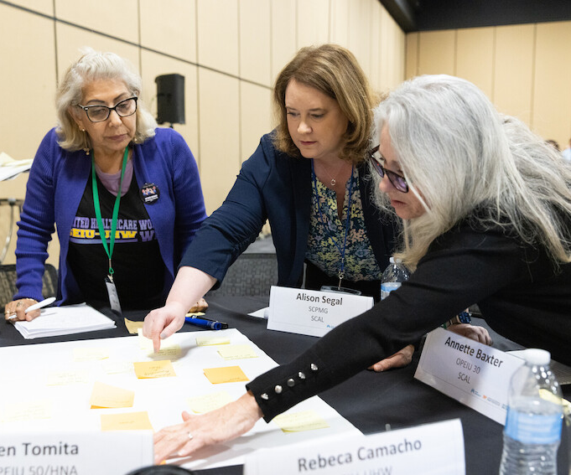
Remote and Hybrid Work
Defines remote and hybrid work, and creates notice requirements and a clear process for changes to/from remote and hybrid positions
Establishes home internet and personal phone reimbursement rates for remote and hybrid employees

Slide 8

Job Security
Preserves existing agreements and limitations on outsourcing and subcontracting

Slide 9
Performance Sharing Plan
2023
Offers guaranteed minimum payout of $1,500 ­– pro-rated for part-time eligible employees—with opportunity for more if performance goals are met
2024 and beyond
Provides opportunity for minimum payout of up to $1,200 if performance goals are met and a potential maximum payout of $3,750, based on achievement of goals and financial performance
Mutually agreed goals and metrics
Controlling High Blood Pressure
Member Flu Vaccination Rate
HCAHPS: Likelihood to Recommend
CAHPS Meteor Care Experience
Regional Attendance

Slide 10
Performance Sharing Plan
2024 – 2027
Goal | Goal Improvement | Market Operating Margin Threshold Not Met¹ | Market Operating Margin Threshold Met² | Enhanced Operating Margin Threshold³
Controlling High Blood Pressure | Achieve 2% improvement year over year. For markets who are at or above the 90th percentile, maintain performance. | $300 | $700 | $950 - Must meet definition of Enhanced Operating Margin Threshold⁴
Member Flu Vaccination Rate | Achieve 1.5% improvement year over year. | $300 | $700
HCAHPS: Likelihood to Recommend* | Achieve 1% improvement year over year. For markets who are at or above the 90th percentile, maintain performance. | $300 | $700
CAHPS: Meteor Care Experience | Achieve 2% improvement year over year. For markets who are at or above 90th percentile, maintain performance.
Regional Attendance | Achieve 2% improvement year over year. | $300 | $700
Maximum Payout Amounts |  | $1,200 | $2,800 | $3,750
*Service goal is equally split between HCAHPS and CAHPS for hospital regions (NCAL, SCAL, NW, HI). For non-hospital regions (CO, MAS, KPWA), only the CAHPS goal applies.
Subject to the following conditions, PSP will pay out for full-time employees, as described below:
1. If the Market’s Operating Margin Threshold is not met but the Health Plan/Hospitals’ Operating Margin Floor is met, the PSP will pay out up to $1,200 based on achievement of the 4 goals.
2. If the Market’s Operating Margin Threshold is met, the PSP will pay out as set forth above up to $2,800 based on achievement of the 4 goals.
3. If the Enhanced Operating Margin Threshold and the 4 goals are all met, the PSP will pay out at a maximum of $3,750.
4. Enhanced Operating Margin Threshold requires achievement of all 3 conditions: a) Health Plan/Hospitals Operating Margin of 2.5% is achieved; b) Market exceeds Market Operating Margin Threshold by 0.75% or more; and c) Where Market Operating Margin Threshold is negative, Market achieves a deficit of less than 50% of the threshold.

Slide 11

Education and Training
Increases funding to the SEIU-UHW West & Joint Employer Education Fund and Ben Hudnall Memorial Trust to further invest in the development of Coalition-represented employees

Slide 12

Labor Management Partnership
Increases funding for the LMP trust fund to support partnership activities

Slide 13
2023 Coalition National Agreement Highlights
SUMMARY OF KEY PROVISIONS FOR WORKERS, MANAGERS, AND PHYSICIANS

