Slide 1


SERVICE RECOVERY
A Comprehensive Guide
Updated: March 2025

Slide 2
Table of Contents
Introduction 3
The Program 3
KP Experience Standards 4
Proactive Surfacing 5
Speak Up Culture and Empowerment 5
Rounding with Staff 6
Daily Huddles and Visual Boards 6
Recognition 7
Communication & Empathy 8
Service Recovery with A-HEART 8
De-Escalating Challenging Conversations 10
Resolution & Recovery 11
Resolution Roadmap 12
Resolution, Recovery, & Empowerment 13
Example Scenarios 14
Tracking & Measurement 17
Tracking Components 17
Recommendations & Decision Points 18
Diversity, Equity, & Inclusion 19
Culturally Responsive Resources 19
Real-Time Feedback (Hospital Setting) 20
HCAHPS Survey 21
NRC Real-Time Survey 22
Service Alerts & Comments 23
Roles & Responsibilities 24
Definition of Service Alerts 24
Service Alert and Recovery Workflows 26
Implementation 29
Daily Management System 29
Assessment 30
Staff Education 31
Validations 33
Bibliography 34

Slide 3




The Program
This guide is intended to provide leaders and their teams with Context, Recommended Actions, and Tools to execute a Comprehensive Service Recovery Program that retains and reinstates the trust of Kaiser Permanente members and patients who have had a disappointing experience.
The guide addresses four (4) operational components that work in tandem to produce a successful approach. Each of these sections can be translated into a speciﬁc work stream or discussion area in a speciﬁc implementation area, service line, or medical center.
Proactive Surfacing
Tracking & Measurement
Communication & Empathy
Resolution & Recovery
Each section highlights core concepts and considerations for the work and includes a list of specific recommendations and decision points to be addressed.
The guide concludes with an implementation outline that pulls the four components back together in an organized fashion to ensure there is clear alignment prior to going “live”. This section also includes suggested roles for involvement and management of the work to ensure stakeholder buy-in.

Slide 4




The Program
KP Experience Standards
At Kaiser Permanente, we recognize the importance of exceptional service recovery and include it in our Experience Standards.
Provide immediate greeting and warm acknowledgement.
Speak positively, building trust and confidence.
If experience falls short, own it!
Ask about and listen to
what matters.
Personalize the experience and honor preferences.
Give choices and options.
Anticipate needs and offer help.
Ensure understanding and summarize next steps.
Provide seamless transitions.
The Case for Service Recovery
The research on the need for robust service recovery is extensive and has been a call to action for consumer-oriented businesses:
Kaiser Permanente’s Comprehensive Guide to Service Recovery is a demonstration of our commitment to empowering staff, re-establishing trust with patients/members, and implementing improvement across the system.
» 96%
of unhappy
customers don’t tell us they are unhappy
» 91%
of unhappy
customers will tell at least 9
other people
» 82-95%
of customers
who complain,
return if they are impressed with the company’s response
A very positive service recovery can even result in stronger customer loyalty than if service failure hadn’t occurred. This is commonly referred to as the service recovery paradox. (Zemke, 2000)
We live in an era of health care consumerism where members have more choice and are comparing their experiences with us to the ones they have with other industries. On top of this, the stakes in health care are often higher and more personal—service missteps can add to stress levels and erode trust if not handled effectively. Service recovery when things don’t go as planned is the right thing to do and supports and advances our brand.
“The numbers are in and the case airtight: companies that perform high quality service recovery realize substantial economic payoff.”
KNOCK YOUR SOCKS OFF SERVICE RECOVERY, ZEMKE

Slide 5
Proactive Surfacing
Proactive Surfacing
Introduction
It may feel as though our members already tell us when things are not going well for them. Conservative estimates suggest that the opposite is actually true. Service errors occur more frequently (with at least 19% of all customers) than we think, and they are less often reported than we might think (less than 50%). (Zemke & Bell, 2000)
An internal study done at Kaiser Permanente found that leadership behavior was the most influential factor in determining whether a speaking-up culture was present. Whenever there is inherent discomfort or risk in raising issues, leaders need to be intentional about creating the environment and employee experience that supports the raising of issues. Consider the following quotes from departments found to have a “Speak Up Culture.”
“ They listen empathetically and don’t blame. They ask, 'How can we make it better?’”
50%
of patients don’t raise their concerns with us
“ Every meeting starts off with gratitude for something, like our scores or our safety record. She thanks us all the time and really means it.”
When complaints are resolved quickly vs. not resolved, the re-purchase intentions (loyalty) increase from as little as 23% to as much as 86%. (Zemke & Bell, 2000.) Clearly, the costs of not surfacing this dissatisfaction could be enormous in terms of member experience, retention, and advocacy. We need to intentionally create a staff and physician experience that appreciates and celebrates the surfacing of issues. Handling issues up front also makes Kaiser Permanente much more efficient. Processing and researching formal complaints is costly and time-consuming for our organization and can be less effective for our members.
Speak Up Culture and Empowerment
A speaking-up culture is one where employees feel free to speak up, provide input, and offer ideas for improvement. This is a culture we want to cultivate at Kaiser Permanente and is ultimately tested in instances where things may be going wrong, mistakes are being made, or members are dissatisfied. If successfully in place, the speaking-up culture will ensure member dissatisfaction is surfaced and addressed early.
Empowerment is another critical aspect of a service recovery culture and can be defined as follows:
Sharing information, rewards, and power with staff so that they can take initiative and make decisions to solve problems and improve service and performance.
We will talk more about empowerment in subsequent sections but for now, it is important to note that more empowered our staff feel, the better we will be at surfacing member concerns.
Fortunately, there are known actions and behaviors we can incorporate into our daily routines that will result in the desired culture and encourage the surfacing of issues. We as leaders can demonstrate that raising member concerns is not only safe but also beneficial to KP and to the fulfillment of our personal mission.
It is important to discuss and put these behaviors in place prior to the launch of a learning program. The next section will cover some of those key practices.

Slide 6

Proactive Surfacing
Sharing the “Why”
Share information about the importance of raising member concerns. This can include:
» The effect on the individual member, and their experience, when an issue is addressed vs. not addressed
» How surfacing concerns helps identify gaps and allows systemic ﬁxes
Rounding with Staff
Rounding with staff is an evidence-based practice that improves employee engagement and is widely adopted within KP. Did you know that rounding with staff can be adapted to engage staff on a particular topic? An example is provided to the right and more information on Direct Report Rounding is available here:
» Learn more about: KP Rounding
Daily Huddles and Visual Boards
Daily huddles (5–7 minutes) are an important activity for conveying real-time information to staff, reinforcing practices, and connecting work to purpose. For templates and more information on huddles, please visit:
» Learn more about: Huddles and Visual Boards
Adding service recovery moments to your huddles is an effective way to keep the practice top of mind. Here are several ideas for doing this:
» Tell a story of how a concern was raised and appropriately resolved
» Share service recovery trends and what is being done to make systematic ﬁxes
» Recognize a team member for effective communication or use of the recovery roadmap
ROUNDING EXAMPLE:
» Make a personal connection
» What’s working well this month with service recovery? Have you been able to surface and resolve any member concerns?
» Who can we recognize for doing a good job with service recovery?
» Based on our members’ concerns, what systems and processes should we be improving?
“ Opportunities for service recovery abound. Any problem that employees who are close to the customer can discover and resolve is a chance to go beyond the call of duty and win a customer for life.“
“THE PROFITABLE ART OF SERVICE RECOVERY”; HARVARD BUSINESS REVIEW

Slide 7

Proactive Surfacing
Recognition
Recognizing and appreciating our workforce is something we can never do too much. Not only does it increase joy, engagement, and discretionary effort, but it also serves as a statement of what we value as leaders and shapes our culture.
» Incorporate service recovery into your formal recognition programs
» Provide in-the-moment recognition when service recovery is observed or learned of
» Include service recovery in huddle messages
» Share service recovery stories at meetings
Recommendations and Decision Points
1. Current State Culture
Use direct report rounding process to assess current state of service recovery culture.
» Managers ask their teams what the most common service recovery issues are within the department and what ideas they have for cultivating a climate where service recovery is celebrated
» Track ideas in a tool (e.g., KP Rounding) and share ﬁndings
2. Coach and Support Leaders
Send regular key messages about Kaiser Permanente’s commitment to service recovery by sharing examples and wins.
» Incorporate service recovery into all senior leader rounding for at least three months (periodically after that)
» Include as a placeholder on all senior leadership agendas
Team Huddles and Visual Boards
Add a “service recovery moment” to at least 1-2 huddles per week.
» Ask your team to share any challenging issues that occurred on a prior shift
» Review and celebrate service recovery successes
Recognition Planning
Ensure service recovery is incorporated into any formal or informal recognition or appreciation activities.
» When starting out, consider highlighting departments which have surfaced and documented the most issues
» Leverage existing communication resources and channels to get message out

Slide 8

Communication & Empathy
Communication & Empathy
Introduction
Service recovery moments present our teams with delicate and complex situations that warrant a step- by-step two-way communication process. Being in health care, our patients and members are often anxious and not feeling well, even when things are going smoothly. When you add inconvenience or perceived rudeness on top of this, the need for empathic communication increases signiﬁcantly. Not surprisingly, it’s not easy for staff either. One study found that 95% of physicians experience stress during the complaint process which is at its highest level upon receipt of the complaint. (Baird, 2000)
Clearly, equipping our workforce with the skills to smoothly interact with dissatisﬁed members needs to be included in our comprehensive approach.
With some minor inconveniences (e.g., parking delays), a sincere apology may be enough. With more complex situations, we need skills that convey empathy, reduce anxiety, and communicate a clear path to resolution.
The A-HEART Model
Great news! Kaiser Permanente has a well-established service recovery communication model called Service Recovery with A-HEART. The A-HEART model incorporates the essential apology and adds the additional key steps that are needed to re-establish trust with our members.
It is important that the A-HEART model is not viewed as something just for the front-line staff, therefore, senior and mid-level leaders should effectively role model and articulate the expectations.
“ Traditionally, apology is viewed as a valuable reward that redistributes esteem and is proved to boost customer satisfaction after service failures.”
(GOODWIN AND ROSS 1992; SMITH, BOLTON AND WAGNER 1999)
Apologize for the experience
Hear the person
Empathize with their feelings
Ask how you can make it better
Resolve the concern
Thank the person

Slide 9
Communication & Empathy
The A-HEART Model Quick Tips
Apologize for the experience Check your reaction. Start with the phrase “I am sorry...” Apologize for the experience. Don’t blame anyone. Don’t start analyzing the concern or problem-solving yet. | Ask how you can make it better Re-apologize for the concern. Ask “What can I do to make this better?” Pause and let the person respond.
Hear the person Let the person tell you what they want to say. LISTEN for their perceptions, concerns, and feelings. Draw out the full concerns if needed. Don’t jump to problem-solving before the person is finished. | Resolve the concern Use their requested solution if possible. Provide additional options so they know all possible solutions. If you are unable to resolve the concern to the person’s satisfaction, follow your department’s service recovery policy.
Empathize with their feelings Use words and phrases that demonstrate caring and understanding. Use body language and tone of voice that mirror your emphatic statements. | Thank the person Start with the phrase “Thank you for...” Appreciate the effort it took for them to express the concern. Mention how their raising the concern allowed you to improve the care for them or for others in the future.
Learning Approach
Although A-HEART may have been incorporated into training efforts in prior years, it makes sense to consider how A-HEART is refreshed as part of a broader service recovery program. That refresh can be done alongside the education needed for the other program components. The evidence-based methods in this web-based service recovery training will help to make your service recovery conversations less stressful. The training will also increase your confidence and mastery when conducting service recovery conversations.
» KP Learn Course: Service Recovery With A-HEART
» Service Recovery on National Care Experience Website

Slide 10


Communication & Empathy
De-escalating Challenging Conversations
When teaching and coaching Service Recovery with A-HEART be sure to include the following strategies to de-escalate challenging encounters. Own the responsibility to ensure an exceptional care experience – everywhere and every time.
Actively listen. Allow the person to vent and listen to seek understanding versus listening with a solution in mind.
Remain calm. Know your triggers and develop coping techniques to prevent yourself from becoming upset.
Always communicate with empathy
Build trust and rapport by assuring understanding with intention to help
Avoid blaming language, such as ‘you should have…your instructions are clear…the signage is right there…”
Ask clarifying questions to help resolve issues and, if needed, explore multiple options.
Follow through and follow up by setting realistic expectations. Keep your commitments!
Recommendations and Decision Points
1. A-HEART Adoption
Set expectations for use of A-HEART within medical center at all levels of leadership.
» Expectations for leaders include supporting, recognizing, and coaching to the model
2. Learning program/tools
Designate a small group of individuals to review the learning tools that are available and develop local learning plan.
» Identify facilitators who can co-facilitate with front-line leaders for staff training
3. Roll-out the learning program only after all other decision points within this guide are addressed.
» The decisions and actions should be included in the learning program.
4. Determine how training will be reinforced annually, for new leaders, and for new
front-line staff
TIPS
Use of these phrases helps to reassure:
“I do understand the inconvenience you have faced…”
“I am more than happy to assist you…”
“I understand the reason why you contacted us…”
Confirm next steps and time-frame.
Be proactive: Is there something you can share to prevent future concerns?
Always ask if there are any other questions.
Use their preferred name; it is a great way to personalized the experience.

Slide 11

Resolution & Recovery
Resolution & Recovery
Introduction
The essence of service recovery lies in how we empower ourselves and our organization to firmly recover our member and patients’ trust when things don’t go as planned. We need to go beyond issue resolution and consider how we have regained trust with our member and provided appropriate amends for any discomfort or inconveniences we have caused. Doing this well can be very rewarding for both staff, members, and Kaiser Permanente at large. Consider how this somewhat unpleasant experience ultimately became a five-star ranking as the result of skilled intervention.
Although the overall program objective is to surface dissatisfaction prior to a social media complaint, this example effectively portrays the power of a responsive interaction.
______________________________________________________
Original Review with Complaint
Horrible time management & customer service! Especially in their dermatology department.
Twice I’ve came here 20 minutes early for my appointment and always been seen 20 minutes after my schedule appointment & instead of apologizing and letting me know what’s going on they are just rude! These nurses need to realized we have jobs too and that they need to work on their time management. I understand things happen, but it would be kindly appreciated if you at least tried to apologize and keep a patient updated with what’s going on! I mean I scheduled this to fall accordingly to my work schedule and now it’s 11:15 am and I have yet to see my doctor and my appointment was at 10:45 am and I arrived at 10:20 am! This is just so unprofessional and the fact that the nurse wasn’t even understanding and told me if I want to reschedule because they are late!? Just upsets me and I really am thinking about changing over my health insurance. Customer service is very important & if you are running late, it’s common courtesy to let the patient know and apologize!
Luckily, the doctor was so kind and sweet that moved my one star to three but honestly nurses need to be more understanding.
Response from Kaiser Permanente Honolulu Medical Office
Jay,
My name is Lance Agena with Kaiser Permanente Hawaii. Let me extend my apologies for the delays you’ve experienced. I am very sorry for this lapse in service. We certainly value your time and appreciate your patience. I’m going to forward your feedback to our leadership to make them aware of the
situation. They will want to address this. Please email me at Lance.i.Agena@kp.org with your member number and any other details about these issues you’d like to share. (To protect your privacy, please don’t respond via Yelp.) Thank you for your feedback and again, I am sincerely sorry for these issues.
Lance Agena
Communications Consultant, Kaiser Permanente Hawaii
Updated Review and Rating
Update---
I appreciate the nurse calling and apologizing and I really appreciate that Kaiser takes the time to read these review and do something about it. It really shows how much they do care about their patient and take their review seriously.
Thank you, Kaiser, for reaching out and the amazing professionalism.

Slide 12
Resolution & Recovery
Resolution Roadmap
A resolution roadmap provides the clarity and shared point of view on how issues get resolved, and how to involve others when resolving them. Without this document in place, service recovery efforts will continue to be inconsistent and frustrating; effectively undermining the culture we are working so hard to establish.
A recommended resolution roadmap is provided below. Components of any successful roadmap include:
» Provision to resolve at lowest level possible
» Explicit escalation steps for unresolved issues
» 24/7 escalation coverage
Resolution Roadmap
RAISE
RESOLVE
RECOVER
Member Concern
Ensure member fully understands breath of resolution
Assess member satisfaction with resolution
Provide compensatory effort if member inconvenience warrants (e.g. token, co-pay waiver etc.)
Leader contact member (as appropriate) to close the loop and share what has been done.
Staff/Physician Surfaces Issue
within department
Initiate
Resolution
outside department
Initiate
Resolution
Can’t
Resolve
within department
DONE
Leader of Staff/Physician
Initiate
Resolution
outside department
Initiate
Resolution
Can’t
Resolve
within department
Designated Person in Charge
Initiate
Resolution
outside department
Initiate
Resolution
The example provided above will be brought to life with some real-life scenarios but ﬁrst, let’s cover some important terminology that is critical for developing the roadmap.

Slide 13
Resolution & Recovery
Resolution
The cornerstones of effective resolution are timeliness and appropriateness (how effective the resolution is at eliminating the root cause of a member’s dissatisfaction). Since the root cause is not always clear, the A-HEART model must be followed to better understand the situation. For example, a member might be complaining about how long it took them to park while in reality, they are concerned that their lateness puts them at risk of losing their appointment time. This also explains why providing service recovery tokens like coffee cards or co-pay waivers is a risky first line of action when a complaint is raised. In most cases, resolution will not involve tokens of this nature and instead need to be focused on the unmet need.
Recovery
In some cases, a service issue may have been resolved by the staff person who encountered it and yet we have not yet fully recovered a member’s trust and loyalty. For example, a 90-minute delay in an appointment might be resolved when the physician is seen, and apologizes to the member, but the member’s lost time has not been accounted for. Another possibility is that an issue from the past is brought forward, and, on the spot, resolution is not possible. In either of these cases and even more broadly, recovery is an important consideration in the roadmap. When the resolution can’t address the actual inconvenience or anxiety that was experienced by the member, further recovery efforts are warranted. Recovery efforts can include such things as an appropriate leader to follow-up and demonstrate a higher-level awareness of the issue. Also, appropriate to
communicate a sense of urgency and sharing what is being done to prevent future occurrences. Sometime, an appropriate recovery token may be helpful for the specific situation and yet should never be used as an alternative to actual issue resolution.
Empowerment & Escalation
Service research supports the notion that the quicker the resolution to an issue, the larger the impact. Resolving issues quickly can mean only one thing: empowerment. Giving staff the knowledge and guidelines to make decisions that address member issues has profound impacts on both the member and staff experience. These “Degrees of Freedom” enable quicker decision making for both resolution and recovery efforts up to and including the provision of tokens. For example, staff might be empowered to “work a member into the procedure schedule” under certain circumstances or assign another clinic provider when the waiting time is much longer than anticipated or expected. At any rate, staff must have resources available to direct towards the problem and appropriate freedom to make great experiences happen.” Efforts to empower can start with the learning process but must be continued with reinforcing behaviors. When collaboration with other areas or departments is needed in a recovery effort, those team members must also be empowered and show the same level of urgency as the staff member who initially surfaced the concern. When issues can’t be resolved at the first line, quick escalation will ensure those issues can shall be resolved as quickly as possible. The Resolution roadmap includes an escalation pathway which are raised to a higher level of leadership. It must be clearly understood and broadly respect by all staff.
ADVERSE EVENTS
It’s critically important to assess whether a complaint is connected to an adverse event or perception of such, or in any such case where there is perceived or real harm to the patient or member. In these cases, there are multiple considerations, and a different Kaiser Permanente protocol must be followed. That protocol may involve the inclusion of the Healthcare Ombudsman/Mediator and the use of different communication techniques that reference “Reporting Adverse Outcomes”. For more information on this protocol, contact the local Quality Assurance and/or Risk Management Departments.

Slide 14
Resolution & Recovery
The following two scenarios can be used as starting points for discussion and are intended to provide examples of how the recovery pathway can be used to resolve member issues and recover trust. The red arrows in the recovery pathway indicate how the pathway is being followed based on this specific scenario.
Scenario #1
RAISE
Upon checking in for an appointment, the member expresses disgust at the condition of the restroom down the hall. The receptionist uses the A-HEART model and lets the member know that he will be calling to have the issue resolved immediately.
RESOLVE
Since there are several people waiting to be checked in, the receptionist quickly gets a medical assistant to contact the Environmental Services hotline and lets them know of the complaint and issue. The Environmental Services team recognizes the urgency of the problem and contacts the staff responsible for that area who immediately proceeds to clean up the bathroom.
RECOVERY
The Environmental Services Leader seeks out the member, introduces herself and uses the A-HEART model to apologize, thank the member for raising the issue, share what’s been done, and ask if there is anything else that can be done for the member.
RAISE
RESOLVE
RECOVER
Member Concern
Ensure member fully understands breath of resolution
Assess member satisfaction with resolution
Provide compensatory effort if member inconvenience warrants (e.g. token, co-pay waiver etc.)
Appropriate leader contact member (as appropriate) to close the loop and share what has being done.
Staff/Physician Surfaces Issue
within department
Initiate
Resolution
outside department
Initiate
Resolution
Can’t
Resolve
within department
DONE
Leader of Staff/Physician
Initiate
Resolution
outside department
Initiate
Resolution
Can’t
Resolve
within department
Designated Person in Charge
Initiate
Resolution
outside department
Initiate
Resolution

Slide 15
Resolution & Recovery
Scenario #2
RAISE
A member expressed the following concern: “…(it is) time to train your staff and revise your protocols to care for your non-binary and trans patients. Your facilities are unwelcoming and misgendering is harmful. When welcoming patients to your KP facilities “Hello” is sufficient. Stop saying “Ma’am” or “Sir” at every turn. In KP medical records, use a different color to highlight our gender pronouns. Your staff told me they could use a pop-up screen for pronouns on records. Long overdue name change needed for your “well woman exam”. My KP doctors, nurses, lab techs, pharmacists and more are telling me about the fixes they need for awareness. Some doctors are training their own staff in advance of my visits but there does not seem to be consistent and comprehensive training for all employees.” The member stated that their issue has occurred in several facilities and requests a call from management to address their concerns.
RESOLVE
Member Services reviews complaint and requests that the Operations Leader contact the member to hear their concerns. The Leader opens with an apology for the poor experience. She acknowledges that although staff are trained annually more consistent reinforcement is needed to ensure that gender identify is respected. Also shared several work-flow changes in the works that will better support signage and electronic medical record documentation.
RECOVERY
The Leader reinforces that KP respects the needs of the transgender community and will personally follow-up with the identified departments. She also invites the member to connect with Advisory Council Patient Partners working with KP to improve transgender care.
RAISE
RESOLVE
RECOVER
Member Concern
Ensure member fully understands breath of resolution
Assess member satisfaction with resolution
Provide compensatory effort if member inconvenience warrants (e.g. token, co-pay waiver etc.)
Appropriate leader contact member (as appropriate) to close the loop and share what has being done.
Staff/Physician Surfaces Issue
within department
Initiate
Resolution
outside department
Initiate
Resolution
Can’t
Resolve
within department
DONE
Leader of Staff/Physician
Initiate
Resolution
outside department
Initiate
Resolution
Can’t
Resolve
within department
Designated Person in Charge
Initiate
Resolution
outside department
Initiate
Resolution

Slide 16

Resolution & Recovery
Recommendations and Decision Points
Identify some of the most common local service recovery issues and develop a shared point
of view on appropriate resolution and recovery.
Using the examples provided in the guide, customize a local resolution roadmap that can operate for 24 hours a day and 365 days per year.
Incorporate resolution roadmap into learning program.

Slide 17

Tracking & Measurement
Tracking & Measurement
Introduction
A key outcome for an effective service recovery program is organizational learning. At Kaiser Permanente, it means that we identify service recovery themes and root causes and address them systematically to reduce our service recovery “load”.
Service recovery incidents are a very rich source of member experience insights because they help us pinpoint where our existing system is not working for the members that we serve. When we include service recovery insights in our performance improvement prioritization process and programs, we are living our mission.
Tracking service recovery provides us with the information that allows us to communicate among our team and reinforce a service recovery culture through huddles, staff meetings, and recognition activities.
Components
Effective tracking and measurement can be boiled down to three components that work in tandem to reinforce the overall program and hardwire improvements.
1. Technology: Store, Trend, and Report
2. User Input: Timely and appropriate
3. Review: Regular and intentional
Good tracking allows us to measure our experience pitfalls and make systematic improvements that address any people, process, or technology issues. Remember that within a Speak-Up culture, we want to encourage the input of issues and therefore not assume that an increase in issues equals a decline in experience performance.
We should look at the types of issues that are coming up and should expect to see declines in those issues as we put improvements in place. The best performance measures will be seen further downstream in reduced complaints and higher overall experience ratings.
A regular review process that is proactively scheduled is essential to establishing a culture of learning.
“80% of customer problems are caused by bad systems, not by bad people”
--Dr. Wendy Leebov, “Service Savvy Healthcare: Achieving Impressive Service One Goal at a Time”

Slide 18
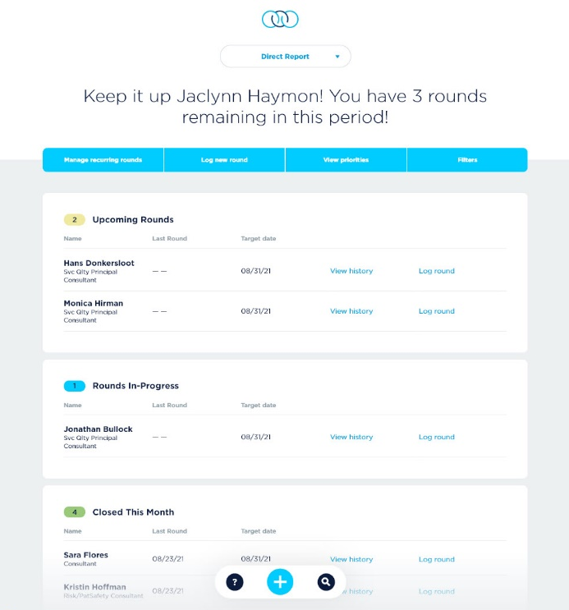
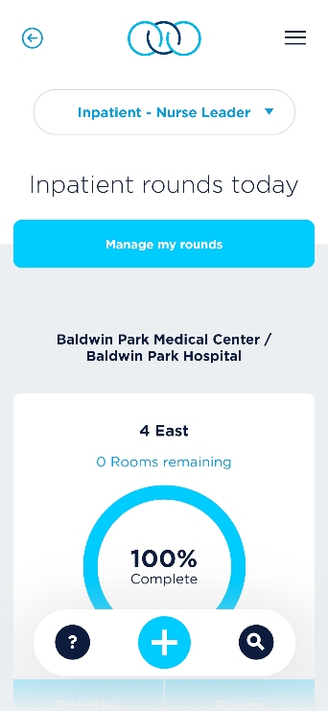
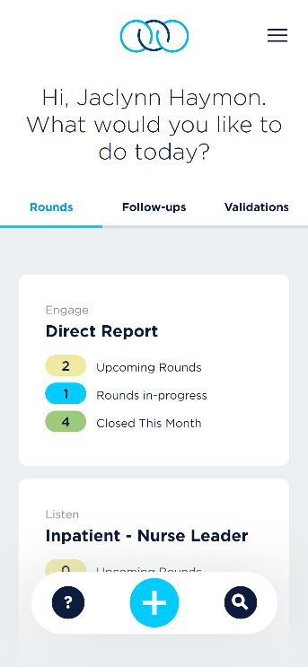
Tracking & Measurement
Considerations of the review process include frequency, length of time, structure, and attendees. Outcomes from the meeting should include the operational follow- up and the broad communication on ﬁndings and how things are being addressed. That reinforces a leadership message of responsiveness and commitment to the opportunities raised by all.
Recommendations and Decision Points
KP Rounding is the recommended tool for tracking service recovery from an operational standpoint (note that service alerts, service recovery comments, complaints and grievances (regulated) are tracked in different systems).
Ensure administrative set-up is current and KP Rounding administrator familiarity with service recovery functionality and reports.
Determine frequency of review gatherings. Meetings should be monthly or even weekly at the during the launch phase. At this early stage of the program, all the elements of the program are coming together and there is a critical need to gather quick wins and deepen clarity on the new processes.
Determine meeting attendees and structure:
» Participants to be a cross-section of the organization including an executive leader, the key patient-facing leaders who represent the higher volume issue areas, Care Experience leads, Improvement Advisors, and other operational leads who will partner on solutions. Ad-hoc attendees based on content.
» Develop clarity on agenda, structure, and process review.
Incorporate learnings into overall communications plan to promote wins, stories, and process improvements based the program.
KP Rounding Features

Slide 19

Diversity & Inclusion
Diversity, Equity, & Inclusion
Culturally Responsive Resources
As we begin to understand the uniqueness of cultural experiences, we can see that building trust, through effective communication, is important to understand our members’ needs. We know that if members do not trust us, they will not follow treatment plans, may leave the health plan, and even worse experience poor health. This is especially important when conducting service recovery.
Keep in mind that cultural experiences are not only related to one’s race or ethnicity but also include sexual orientation, gender identity, religious/spiritual affiliation, age group, and more. Be mindful of how all these identities may impact how members and patients engage with our services.
» National Equity, Inclusion, and Diversity SharePoint Site
» National Care Experience Health Equity Resources

Slide 20

Patient Experience Feedback
Why Real-time Feedback?
In the era of fast connectivity and one-click services, consumers have high expectations and low patience. Today, we cannot compete only on quality and affordability. We must offer exceptional care experience based on real-time customer feedback.
Real-time is the future of engagement
To provide exceptional care experience, we must understand the problems our member/patients are facing, and real-time surveys assist in doing just that. Timely responses to the surveys allows for teams to close the feedback loop as early as possible and re-establish trust with our members.
In the age of social media, negative feedback can go viral in no time and harm the KP brand. To prevent this, maximize real-time feedback and make provisions to solve issues as soon as possible. Real-time outreach and acknowledgement and a sincere apology go a long way to rebuilding trust between members/patients and our teams.
Building customer loyalty and trust
Immediate responses make our members/patients realize that they are important and their opinion matters.
With powerful real-time data, we create an environment that makes every member’s experience positive and productive.
When we satisfy our members/patients, they will spread the word and remain loyal KP members into the future.

Slide 21
Patient Experience Feedback
HCAHPS & Real-Time Surveys
What is the HCAHPS Survey? (All Market Inpatient Hospitals)
The Hospital Consumer Assessment of Healthcare Providers and Systems (HCAHPS) survey plays a crucial role in standardizing the measurement of patients' perspectives on hospital care. Its national, standardized approach allows for valid comparisons across hospitals, locally, regionally, and nationally. This not only benefits patients by providing transparent information about the quality of care they can expect, but also serves as a catalyst for hospitals to improve their services.
The public reporting of HCAHPS results through platforms like Care Compare on Medicare.gov enhances accountability and drives hospitals to prioritize quality of patient care experience and care. Furthermore, the incorporation of HCAHPS into the Inpatient Quality Reporting Program (IQR) adds a financial incentive for hospitals to actively engage in collecting and utilizing patient feedback to improve their practices.
The Hospital Consumer Assessment of Healthcare Providers and Systems (HCAHPS) KFH Star Report is strongly recommended for regular use by all medical centers. It reflects our collective “voice of the patient” results on fundamental evidence-based practices and all HCAHPS domains.
Overall Rating of the Hospital
Would Recommend the Hospital
Nurse Communication
Doctor Communication
Responsiveness of Staff
Communication about Medication
Discharge
Care Coordination
Restfulness of the Hospital Environment
Cleanliness of the Room
Information about Symptoms
“
2025 HCAHPS Survey Changes
In January 2025, CMS introduced new outreach methods for HCAHPS surveys, including Web-Mail (mixed-mode) outreach. These changes aim to accelerate the return of survey responses and enable patient proxies to complete the survey. As a result of this change, we will also receive service alerts and recovery opportunities at a faster pace.

Slide 22

Patient Experience Feedback
NRC Real-Time Survey
(Northern & Southern California, Hawaii)
The NRC Real-Time (RT) survey is an electronic tool designed to measure patient experience alongside the HCAHPS survey. This method involves dividing patient discharges into two groups: some patients receive the official HCAHPS survey by email/mail starting 48-72 hours of discharge (required by CMS), while others receive the Real-Time survey via email, SMS text, or IVR phone call 24-72 hours post-discharge. The original advantage of the Real-Time survey is its ability to provide quicker data results compared to the HCAHPS survey. In mid 2025, an CMS will conduct an analysis to evaluate the differences in response between the two surveys.
Additional benefits of both HCAHPS and Real-Time surveys include:
Actionable Insights:
Allows for quick identification and resolution of issues while the patient experience is still fresh. This can lead to immediate improvements in care and service.
Quick Response:
Allows for rapid analysis of data and immediate response to emerging trends or issues.
Patient experience surveys should be viewed as early warning systems. The scores may tell us where we are doing well and where we have room for improvement, but they do not tell us how to fix the problems patients identify in their responses. After receiving their HCAHPS results, many people ask me if they should do another survey to identify more detailed intervention strategies. The answer is ‘no’! Instead, it is critically important to go beyond scores and take a deep dive into patient comments and service alerts to identify the details of negative experiences and potential solutions that patients often share in their comments.”
Susan Edgman-Levitan, PA
Principal Investigator, Yale/Harvard CAHPS Consortium, Executive Director, John D. Stoeckle Center for Primary Care Innovation, Massachusetts General Hospital
“

Slide 23

Patient Experience Feedback
Service Alerts & Comments
Service Alerts
Through both HCAHPS and NRC Real-Time surveys, patients have the valuable opportunity to provide feedback in free text, sharing their experiences and insights. This qualitative data is crucial for Kaiser Permanente, as it captures nuanced perspectives that quantitative data alone may miss.
To enhance our understanding of patients’ experiences, service alerts leverage Natural Language
Processing (NLP) technologies, which help sort, organize, and categorize human language. These tools analyze free-text responses to identify and group parts of comments into common themes and sentiments. If the NLP detects comments related to specific topics (as seen below in alignment with CMS guidelines for complaints and grievances), the encounter will be marked with an automatic comment alert and the assigned user will receive a daily summary email from NRC..
Alert Topics (Link to NRC Alert Criteria)
Clinical Errors | Comments where patients perceive or suspect an error or omission in care. This includes medication dosage errors, wrong tests, incorrect diagnoses, and allegations suggesting caregivers lacked knowledge, failed to review medical records and test results, or comments about low competence and negligence.
Contact Request | Comments where there is an expectation of follow up, a direct or indirect ("if anyone reads this") plea for help, a sense of urgency of need ("please respond"), a reference to follow-up that is not yet fulfilled, or the comment contains a person's email address or callback number.
Legal Risk | References to potential liability or legal issues such as filing a complaint, lawsuits, malpractice, HIPAA violations, informed consent, lack of confidentiality, identity theft, fraud or theft of personal items. Includes references to dying or nearly dying during or after the healthcare encounter.
Mental Health | Mentions of potentially life-threatening mental health issues such as doing harm to oneself or a strong desire to hurt others, references to methods of suicide or homicide.
Mistreatment or Abuse | Perceived mistreatment of the patient or others during the healthcare encounter. Description of feeling threatened, allegations of aggression, racism, sexism, discrimination, coercive behaviors or physical abuse. NRC does not include less serious concepts such as being abrupt, unfriendly or somewhat rude in this category; those concepts are captured within Courtesy and Respect's negative sentiment or within the negative emotion of disrespect.
Negative Experiences Global Triggers | Expressions of significant dissatisfaction with providers or care, expressions of clear anger, and references to unsafe or dangerous conditions. Expressing an intent NOT to return for future care. Name-calling or vulgar expressions.
Warning Signs and Symptoms | Descriptions of post-visit symptoms and issues that may warrant follow-up, such as not healing, having an allergic reaction, getting worse, ongoing side effects or an infection.
No automated system can interpret the full meaning in human expressions as well as a human reader. When your team encounters an automated comment alert, but you find the comment is not aligned with any of these definitions, we recommend "Remove alert" as the best action and/or emailing CustomerSupport@nrchealth.com requesting the flag be removed.

Slide 24
Patient Experience Feedback
Roles and Responsibilities
Clarity regarding roles and responsibilities should be communicated to local leadership teams when establishing your service alert review process. Below is a reference guide for discussing individual roles and responsibilities to effectively handle Service Alerts.
Role | Responsibilities
Care Experience Leaders | Provide oversight of all red flag alerts, service recovery, and improvement opportunities to ensure timely action. Manage escalations and partner with local members of their escalation team as needed.
Department: NM/ANM/DA/ADA | Use A-HEART to conduct service recovery for alerts that do not meet red flag alert criteria.
C-Suite + Physicians (APICS) | Be informed unless it’s high level enough warranting this level of service recovery.
Direct Care Staff (should not contact patient) | Front-line Nurses, Front-line physicians, anyone who would have been involved with the caregiving of the patient during their stay.
Definitions of Service Alerts
Service Alert Criteria* These are comments in the NRC Experience platform that are flagged by Natural Language Processing (NLP) because they meet CMS’ service alert criteria.
*Please note: Due to current NLP limitations, some comments may be incorrectly flagged as Service Alerts or may require manual alert assignments (such as Service Recovery alerts). Care Experience leaders have the ability to unflag comments incorrectly marked as Service Alerts or to manually flag Service Recovery Alerts to initiate recovery actions. For more information on this process, please contact NCEADept@kp.org.
Service Alert Criteria Meets CMS guidelines for high-priority comment criteria 1-5. Issue must be triaged within 24 hours and resolved within 72 hours from the "comment added" date/time.
Criteria 1a | Grievance - a complaint regarding abuse, neglect or harm arising in connection with a patient's hospitalization. Does NOT include complaints about billing, housekeeping, food, etc.
Criteria 1b | Grievance - a complaint about any aspect of care in which the patient states their wish to file a formal grievance or requests resolution.
Criteria 2 | Death of a patient
Criteria 3 | Malpractice / situation became worse as a result of provider care
Criteria 4 | Sexual / racial misconduct or harassment
Criteria 5 | Threat of lawsuit

Slide 25
Patient Experience Feedback
Service Recovery Comment
Comments that do not meet the requirements of a Service Alert can be treated as a Service Recovery Comment. Elicits an apology to patient and follow up actions. Patient should be contacted within 48 hours from time service recovery comment was added to NRC Experience platform. **Reminder: No direct care staff can contact patients including physicians.** Department Leaders to use their own discretion as to which comments fall into this criteria. Key factors to consider in alert assignment:
How significant is the level of dissatisfaction / anger
Will calling the patient be beneficial to the patient or if it will do more harm
Number of complaints in one comment
Perceived medical impact of KP’s alleged actions
How the patient responded to all survey questions
Differences between Real-Time and HCAHPS Patient Outreach
Outreach Type | Real-Time | HCAHPS
Contacting Patients | RT is not anonymous, contacting patients is permitted. | HCAHPS is considered anonymous, contact patients using discretion, only when appropriate.
Service Alert: Patient comment triggered “Service Alert” meeting CMS criteria | Follow Service Alert Workflow | Follow Service Alert Workflow
Service Recovery Comment: Patient comment elicits the need for service recovery but does not meet CMS Criteria for “Service Alert” | Ok to contact | New! OK to contact from quality improvement lens.
Patient score for “Recommend Hospital” and other survey measures are low, with or without a comment. | Ok to contact | Do not contact
Patient score for “Recommend Hospital” measure is low while other survey measure scores are med-high, with or without a comment. | Ok to contact | Do not contact
Patient score for “Recommend Hospital” and other survey measures are med-high, with or without a comment. | Ok to contact | Do not contact
Patient requests to be contacted, and/or leaves identifying information such as Name, MRN, Phone Number. | Ok to contact | Ok to contact
Patient response does not elicit need for contact | Ok to contact with a thank you for your feedback. See RT response templates. | Do not contact

Slide 26
Patient Experience Feedback
Comments, Service Alerts, & Service Recovery Workflow
Comment Meets Service Alert Criteria
*Escalation must be triaged within 24 hours and resolved within 72 hours
Consult with Care Experience Leader
Dept. Leaders contact Care Experience leader within 24 business hours of receiving alert to consult and determine escalation pathway. DO NOT follow up with patient for service recovery.
Escalation Pathway
Care Exp team leads issue resolution and shares the comment with local members of following teams (as appropriate) to triage the issue: Department Leaders Member Services Compliance Quality, Patient Safety & Risk HCOM (Ombuds mediator) - If emailing with other recipients, send as BCC for FYI only.
Care Experience Team Documents
“Issue met criteria (1-5) for service alert” “Comment sent to appropriate dept(s).” Document alert closure as Resolved in: HCAHPS Comment Log Template for Service Alerts or NRC Real-Time Portal Please visit: Real-time Service Alert and Comment Training_2023.pptx on National Care Experience Analytics – Home
Comment Elicits Service Recovery (Does not meet Service Alert Criteria)
*Contact should take place within 48 business hours of receipt of comment
Apologize & Seek Understanding
Manager calls the patient to apologize using A-HEART model Verify patient identity with 2 identifiers, such as birth date and MRN. Ask for additional details that would be helpful in resolving the issue(s).
Take Action:
Initiate Steps to Resolve Issue. Actions may include: Coach staff if needed using the Coaching for Excellence model. Communicate w Other Depts / Physicians to: Identify who is calling the patient (contact patient just once) No direct care staff can call patient per CMS guidelines Request action for resolution FYI feedback - per manager discretion (All Support Services depts are expected to be subscribed and reading their comments / alerts.) Share unit learnings – bring to huddle, adjust/create new processes. Include learnings in future trainings.

Slide 27
Patient Experience Feedback
Comments, Service Alerts, & Service Recovery Workflow (cont.)
Document actions and/or patient contact
Use HCAHPS Comment Log Template for Service Alerts
When issue resolution is initiated, document alert closure
Use HCAHPS Comment Log Template for Service Alerts
Additional Workflows - “What Ifs”
What if | Resolution
Alert Assigned in Error by NRC | Email Customersupport@nrchealth.com and ask to remove
Alert is not referencing any action on your unit | Comment should be directed to the director of the department in question to resolve
Alert states issues with multiple departments | Service recovery should be performed by Nursing Leadership and outcomes should be shared with other involved department leaders. Patient should NOT be contacted more than once if performing service recovery. If Nursing is not indicated in comment, then department and care experience leaders should discuss who would be best to contact patient. Other department leaders should be followed up with post patient contact.

Slide 28
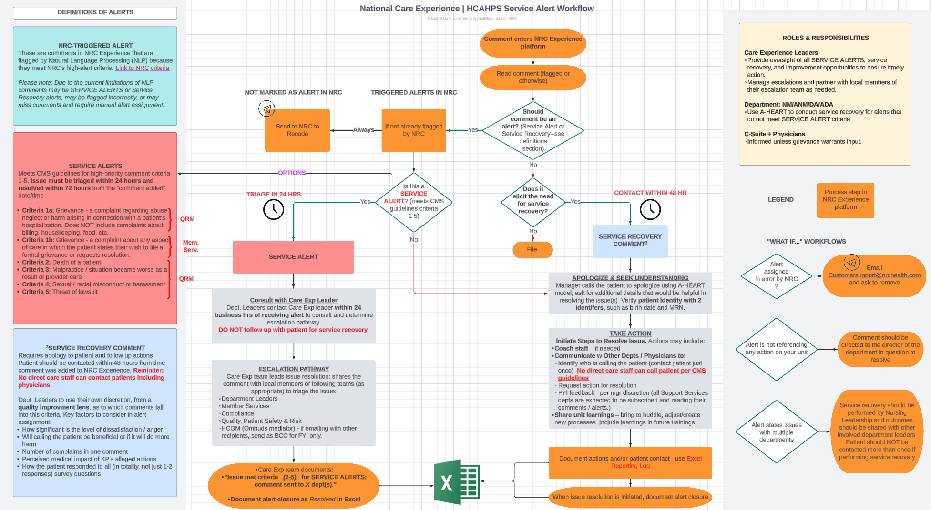
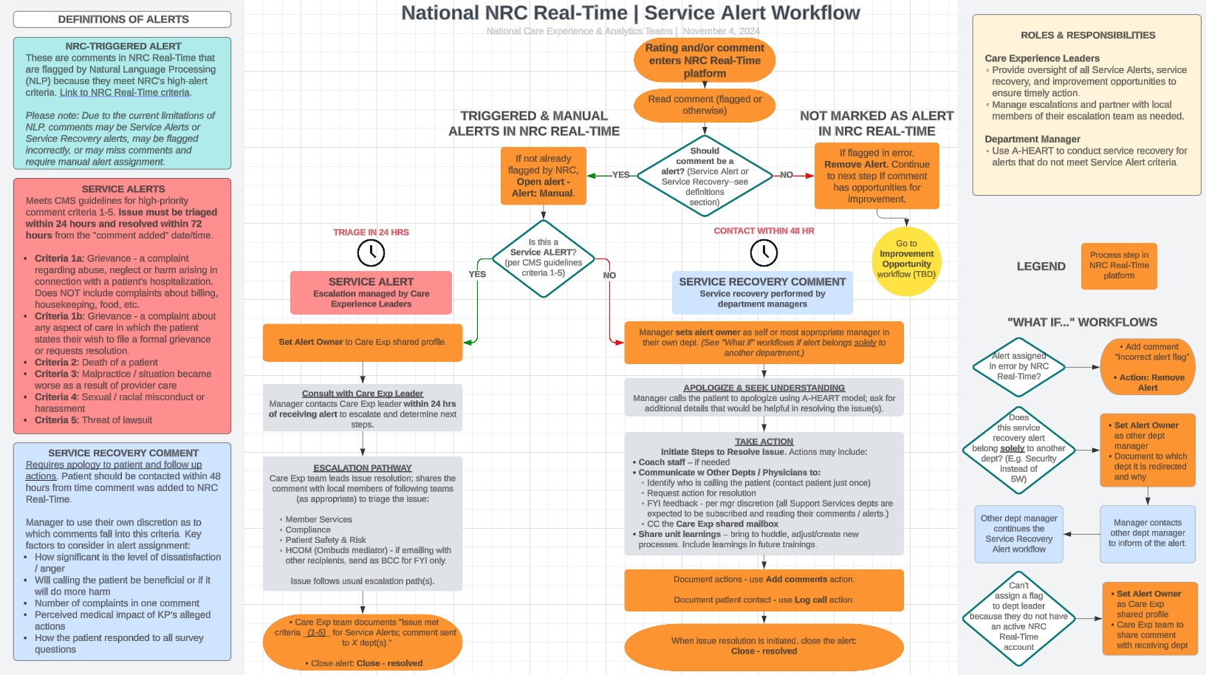
Patient Experience Feedback
HCAHPS Survey | Service Alert Workflow (Link to Chart)
NRC Real-Time Survey | Service Alert Workflow (Link to Chart)

Slide 29



Implementation
Implementation
Introduction
Investing the time and thought into a comprehensive plan will pay dividends for leaders down the road in terms of sustainable results and reduced needs for re-starting or refreshing.
Each of these stages is enabled by core practices that are familiar to many in Kaiser Permanente and are backed by learning content and tools.
“ Many health care systems are not doing service recovery well because they have pieces, but not a system in place.”
—KRISTIN BAIRD, RN, BSN, MHA, CEO/President
Baird Group
KP’s Daily Management System
With engagement and empowerment in mind, each practice is not a checklist or “thing to do” but is a vehicle for advancing meaningful results.
Focus on the power of individual connections, unique needs, private input, and personalized messaging.
Focus on the power of team as a whole and the unique dynamics of team collaboration, iteration, and celebration.
Focus on the power of rapid escalation and resolution and the bigger picture, trends, and systemic fixes.
Focus on the power of the clear leadership activities to establish consistent routines that drive results.
A suite of courses that helps leaders drive operational results and enhance patient and workplace safety through effective staff engagement.
Leader Standard
Work

Slide 30

Implementation
Assess
1. Review common member complaints, comments, service alerts, etc. from KP Rounding, Real-time systems, survey vendors, and other existing processes to understand opportunities.
2. Make service recovery a focus of monthly direct report rounding. Ask staff what ideas they have for improving service recovery efforts. Document and categorize learnings.
3. Identify champions or early adopters of service recovery who are willing to go first and share learnings with others.
4. This guide addresses key performance improvement questions as shown below. Teams can use this
guide as a resource for developing their own AIM statements as desired.
Foundational Performance Improvement Questions | Service Recovery Answers
» What are we trying to accomplish? | » Improve member and patient experience by surfacing and addressing concerns quickly and effectively.
» How will we know that a change is an improvement? | » Fewer member grievances, negative comments, service alerts, and negative reviews. » Improved performance and member loyalty
» What changes can we make that will result in improvement? | » Implement and sustain a comprehensive approach to service recovery based on well-established evidence and practices

Slide 31

Implementation
Set Expectations
1. Expectations are critical to bringing everyone to a common understanding and helping people see and understand their role in a broader context. Prior to any educational activities, expectations should be widely communicated so that staff can focus on what they need to learn and not on contemplation of their changing role.
2. Discuss and determine clear expectations for:
» How key practices will be used to drive the culture (e.g., huddles, rounding)
» Use of the A-HEART communication model
»The learning approach, including which learning assets, educators, and the sequence and timing for educating all teams
» Use of the Resolution Roadmap document
» Planned date for formal validation and completion
» Use of KP Rounding and/or Real-time system to track service recovery issues
» Regular check in meetings
Document all expectations on a summary document.
Develop and deploy a service recovery communications plan that leverages use of all available channels including senior leader rounds, staff meetings, e-mail, internet etc.
Educate
Develop training schedule, assess number of learning facilitators needed.
Through use of available assets and local information and scenarios, customize learning content and receive endorsement from senior leadership.
Train facilitators and deploy education plan. Leaders should co-facilitate their department sessions whenever possible and sessions should include simulation of skills and process.
Advance Skills
1. Plan a follow up skills lab for each department after initial education/training to ensure skills and understanding are advancing.
2. Use observation and feedback model to debrief with staff after a service recovery moment. The debrief process can focus on both the use of A-HEART and the Resolution Roadmap. Particularly with service recovery, which can sometimes be a challenging or intimidating situation, leaders will need to focus on recognizing and appreciating positive behaviors.
3. Ask staff to complete a self-assessment several weeks post training and prior to the planned formal validation date.
4. Leverage formal debrief sessions to simulate skills, discuss resolutions and recovery efforts, and advance collective insights around ideal practices.
5. Reinforce the importance of service recovery through the use of these highly reliable practices.

Slide 32
Implementation
Skill Implementation
Direct Report Rounding | Ask, “What’s working well with service recovery this month?” on your direct report rounds.
Huddles & Debriefing | » Recognize a team member during huddle for resolving and escalating a concern appropriately. Ask team members to share an experience . » Debrief on the month's service recovery issues at a team meeting or other regular gathering. Establish a climate of appreciation and learning
Visual Boards | Highlight service recovery lessons, stories, recognition and systematic fixes on appropriate sections of board.
Leader Patient / Member Rounding | Rounding with patients and members may uncover dissatisfaction and when it does, use this as an assessment, recognition, and learning opportunity for the team involved.
Speaking Up Culture | When employees raise a service recovery issue, be sure to appreciate them for bringing the issue forward and the benefits to the team.
Recognition | Include service recovery in your recognition practices particularly with every day recognition. Focus on recognizing staff who surface issues and follow the new resolution roadmap
Empowerment Tip
To effectively empower your team and support a learning culture, it is important to choose the appropriate coaching practice based on expectations and degrees of freedom. » Use Observation Debrief when judgment, member voice, and subjectivity play an important role. Appropriate for reviewing resolutions to member concerns or when reviewing multiple practices of A-HEART » Use Investment Coaching when expectations are clear and focus is on one practice, e.g., apology LEARN MORE: Coaching for Excellence

Slide 33

Implementation
Formal Validation
1. Use a skills lab format to assess competency in the A-HEART model using known scenarios.
Formal validation skills labs should only include the validators and one staff member at a time and not the entire team. If real-life situations present opportunities to formally validate, then those staff members can be deemed competent based on observation.
2. Allow three attempts to become formally validated and use the formal validation conversation guidelines to ensure clarity around success.
3. After three unsuccessful attempts, use the Expectations Coaching model to uncover barriers and develop plan for competency.
LEARN MORE: » Expectations Coaching Resources
Sustain
1. Integrate service recovery expectations into annual performance evaluations using applicable system (e.g., Total Performance: Focuses on the Member/ Patient/Customer)
2. Ensure appropriate educational components and formal validation is in place for all new staff and leadership hires.
3. Conduct regular (monthly or quarterly) debrief sessions where service recovery moments are reviewed and prioritized for systematic improvements. These sessions are also a good time to continue the learning process and recognize the efforts of individuals and teams.
4. Continue use of core practices (e.g., rounding, coaching) to create a reinforcing cycle of insights, improvement, coaching and recognition.
5. Monitor and regularly report on key metrics (survey measures) and indicators (complaints, grievances) established.

Slide 34

Bibliography
“An empirical study on service recovery satisfaction in an open and distance learning higher education institution in Malaysia”, International Review of Research in Open and Distributed Learning, 2020
A Complaint is a Gift: Using customer feedback as a strategic tool, Janelle Barlow & Claus Moller, Berrett-Koehler Publishers, 1996
“The buffering effects of salesperson service behaviors on customer loyalty after service failure and recovery”, Journal of Managerial Issues, 2015
Communicating with patients about unanticipated adverse outcomes”, Implementation Guidelines, March 2002 - Developed and distributed by KFH/HP & The Permanente Federation LLC
“Customer first: Loyalty through service recovery”, Vanguard News, 2013
Customer Service in Health Care, Kristin Baird, Jossey-Bass, 2000
“Dealing with patient complaints”, Avant Mutual Group Limited, 2009
“Does service recovery affect customer satisfaction? A study on co-created retail industry”, Procedia - Social and Behavioral Sciences, 2014
“Do it right this time: The role of employee service recovery performance in customer-perceived justice and customer loyalty after service failures” Journal of Applied Psychology, 2007
“Don’t fix the product, fix the customer and marketing.” e-Satisfy/TARP, 2001
“Empowerment, attribution, and apologizing as dimensions of service recovery: An experimental study” International Journal of Service Industry Management, Vol. 9, Issue 1, 2006
“The effects of service failures and recovery on customer loyalty in e-services: An empirical investigation”, Foundation for Science and Technology, Portugal,
“Fixing health care service failures” (Chapter 14) Achieving Service Excellence: Strategies for Healthcare, 2nd Edition, 2009

Slide 35
Bibliography
Guide to Service Recovery, CAHPS: Surveys and tools to advance patient-centered care, Agency for Healthcare Research & Quality, U.S. Department of Health & Human Services, 2015
Knock Your Socks Off Service Recovery, Ron Zemke, AMACOM, 2000
“How Geisinger Health System’s refund promise puts patient experience at the center of the enterprise” Next Generation Patient Experience, Worldwide Business Research, 2017
“A Model of Customer Satisfaction with Service Encounters Involving Failure and Recovery”, Smith, Bolton, & Wagner, Journal of Marketing Research, 1999
“Patient complaints as predictors of patient safety incidents”, Patient Experience Journal, 2015
“Patients’ top complaints? It is not doctors or nurses.” Journal of Medical Practice Management, 2016
“The Profitable Art of Service Recovery”, Hart, Heskett, & Sasser, Harvard Business Review, 1990
“Reduce liability risk by improving your patient satisfaction” Press Ganey, 2008
Repped: 30 days to a better online reputation, CreateSpace Independent Publishing Platform, 2014
“The service encounter: Diagnosing favorable and unfavorable incidents” Journal of Marketing, 1990
“Service recovery in healthcare: Movement from reactive to proactive”, The Beryl Institute Patient Experience Conference, 2015
Service Recovery in the Veterans Health Administration – VHA Handbook, 2004
Service Recovery Workbook - Body of Knowledge Course - The Beryl Institute, 2019
“Service Savvy Healthcare: Achieving Impressive Service One Goal at a Time”, Wendy Leebov, 2012
“When the customer is stressed: Providers of cancer care show how to build loyalty by designing ‘high-emotion’ services.” Harvard Business Review, 2015
“Your fast guide to service recovery: And the importance of that first 60 seconds” Customer-Focus Consulting, 2015
We are here to help!
National-Care-Experience@kp.org

Slide 36
© 2024 Kaiser Permanente. All Rights Reserved. For Internal Use Only.

