Slide 1
BOOSTER KIT
LMP Joint Staffing Training for Coalition Labor and
KP Management
February 2026
Notes:
Facilitator notes: Refer to the Booster Kit Facilitator Guide for complete instructions on the activities below. Select the activities that work best for your audience and the time you have available.
To see table of activities and times, view the Notes Page (select View tab, then, in Presentation Views, select Notes Page).

Slide 2

Introductions
Notes:
Facilitator notes:
Introductions are optional depending on your situation.
If you’re facilitating a short huddle or meeting with an existing team, you may not need introductions at all.
If you’re facilitating for a team with less experience working together or that has new members, consider a short intro for yourself and ask participants to provide brief intros for themselves in chat. Below are some ideas for introductions; select as you see fit.
FACILITATORS: Name, job title, and experience in joint staffing
PARTICIPANTS: Name, co-lead for labor or management, and experience level with joint staffing

Slide 3











Housekeeping
Be present
and participate.
Be prepared; I may call
on you by name.
Close all other running
desktop programs.
The session is
not recorded.
Put mobile devices on
vibrate/mute.
Interaction is mandatory
(chat, discussion, polling).
Use the raise hand icon to ask questions.
Make notes in Resource Guide (printout or online).
Notes:
Facilitator notes:
If needed, go over the housekeeping items that are appropriate for your huddle or meeting. Delete any items on the slide that don’t apply.

Slide 4
ACTIVITY 1: Booster Video and Resource Guide
Video: https://www.lmpartnership.org/how-to-guide/joint-staffing-booster-coalition-labor-and-kp-management
Resource Guide: joint-staffing-resource-guide.pdf
Notes:
Estimated time: 5-10 minutes
Facilitator notes:
BEFORE THE SESSION
Make sure you can access and play the booster video. https://www.lmpartnership.org/how-to-guide/joint-staffing-booster-coalition-labor-and-kp-management
Have the link to the Joint Staffing Resource Guide ready to share. joint-staffing-resource-guide.pdf
INSTRUCTIONS
Show the booster video and share the link to the Joint Staffing Resource Guide.
If needed, spend a few minutes answering questions from participants.

Slide 5
ACTIVITY 2: Knowledge Check
QUESTION 1
What date is your staffing plan due? Select the best answer.
August 31
June 30
December 31
Notes:
Estimated time: 5-10 minutes (for all 5 questions)
Facilitator notes:
After watching the booster video, ask participants multiple-choice questions to reinforce retention of key information.
BEFORE THE SESSION
For a virtual session, use your preferred polling application to create the multiple-choice questions on this and the next 3 slides.
If doing an in-person huddle or team meeting, provide the “Knowledge Check” handout in the Learner Worksheets document.
Note that the correct answers are indicated in bold.
INSTRUCTIONS
After watching the video, ask participants to respond to the questions.
QUESTION 1:
What date is your staffing plan due? Select the best answer.
August 31
June 30
December 31

Slide 6
ACTIVITY 2: Knowledge Check continued
QUESTION 2
What is the main resource available to help you develop your staffing plan? Select the best answer.
National Agreement
Your job description
Principles of Responsibility
Joint Staffing Resource Guide
Notes:
Facilitator notes:
QUESTION 2:
What is the main resource available to help you develop your staffing plan? Select the best answer.
National Agreement
Your job description
Principles of Responsibility
Joint Staffing Resource Guide

Slide 7
ACTIVITY 2: Knowledge Check continued
QUESTION 3
In developing a joint staffing plan, which of the following is true as stated in the National Agreement? Select the best answer.
KP managers or co-leads develop staffing plans for approval by Coalition Labor.
Coalition Labor co-leads develop staffing plans for approval by KP managers or co-leads.
Staffing plans must include meaningful participation and input from Coalition Labor.
Management co-leads can submit a staffing plan without Coalition Labor input if they’re not available.
Notes:
Facilitator notes:
QUESTION 3:
In developing a joint staffing plan, which of the following is true as stated in the National Agreement? Select the best answer.
KP managers or co-leads develop staffing plans for approval by Coalition Labor.
Coalition Labor co-leads develop staffing plans for approval by KP managers or co-leads.
Staffing plans must include meaningful participation and input from Coalition Labor.
Management co-leads can submit a staffing plan without Coalition Labor input if they’re not available.

Slide 8
ACTIVITY 2: Knowledge Check continued
QUESTION 4
Is consensus required before submitting your staffing plan? Select the best answer.
No, a simple majority is sufficient.
Yes, consensus must be obtained from the unit-based team.
Notes:
Facilitator notes:
QUESTION 4:
Is consensus required before submitting your staffing plan? Select the best answer.
No, a simple majority is sufficient.
Yes, consensus must be obtained from the unit-based team.

Slide 9
ACTIVITY 2: Knowledge Check continued
QUESTION 5
Is approval from upper management required before submitting the staffing plan? Select the best answer.
No, UBTs should focus on objective information (e.g., call volumes vs. available staff) to formulate a staffing model that meets the objective need and not worry about what will or will not be approved.
Yes, UBTs should ask upper management to approve the proposed staffing model before submitting it using the online tool.
Notes:
Facilitator notes:
QUESTION 5:
Is approval from upper management required before submitting the staffing plan? Select the best answer.
No, UBTs should focus on objective information (e.g., call volumes vs. available staff) to formulate a staffing model that meets the objective need and not worry about what will or will not be approved.
Yes, UBTs should ask upper management to approve the proposed staffing model before submitting it using the online tool.

Slide 10
ACTIVITY 3: Reflections on Joint Staffing
What do you think is the most important benefit of working together to create a joint staffing plan?
Joint staffing planning is still a bit new. What are some workplace practices you already engage in that can help you and your team work together on your staffing plan?
Where in the process is it important to gain input from UBT members?
What additional support might you need to complete your staffing plan?
Notes:
Estimated time: 5-10 minutes (or longer if desired)
Facilitator notes:
After learners watch the video, facilitate a group discussion by posing some or all of the suggested reflection questions. You may choose to do several reflection activities with just 1 or 2 questions each.
BEFORE THE SESSION
Identify how you’ll facilitate the activity.
Virtual session:
Use slide to show questions you want to address, modifying as needed.
Ask participants to respond in chat or by unmuting their microphones and speaking up.
In-person huddle or meetings: Share questions you want to address using slide or the “Reflections on Joint Staffing” handout in Learner Worksheets document. Modify these if needed to show the questions you’ve selected.
Ask participants to respond verbally or by taking notes on the “Reflections” handout or on flip charts or a whiteboard.
Familiarize yourself with possible answers to each question and be open to additional responses by participants.
INSTRUCTIONS
Facilitate the discussion, staying within the time limit you’ve set.
POSSIBLE REFLECTION QUESTIONS AND EXAMPLE RESPONSES
What do you think is the most important benefit of working together to create a joint staffing plan?
It can result in more efficient and effective staffing plans.
Plans benefit from input by staff with lived experience implementing past plans or lack of plans.
Employees on the front line have critical information that can inform plans that can survive daily circumstances, including unplanned shortages, breakdowns, etc.
Joint staffing planning is still a bit new. What are some workplace practices you already engage in that can help you and your team work together on your staffing plan?
Daily huddles
Team meetings
Consensus decision making and interest-based decision making
Participants may offer many other practices
Where in the process is it important to gain input from UBT members?
When gathering information in preparation for staffing planning, UBT members may be excellent sources of some of the information.
During the initial UBT meeting, members may have valuable insights and information.
UBT members may continue to contribute general or specialized knowledge throughout the process as co-leads meet offline or with the team.
UBT members can help improve or fine tune the plan as they review and provide consensus.
What additional support might you need to complete your staffing plan?
Access to data
Help with barriers (escalation pathway)
Tutor or mentor
Help with the worksheets or inputting info into online app

Slide 11
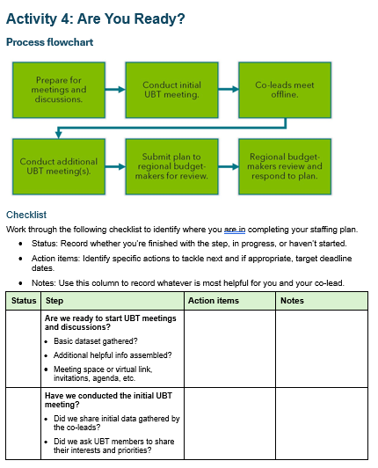
ACTIVITY 4: Are You Ready?
Work through the 2-page checklist to identify where you are in completing your staffing plan.
Status: Record whether each step is complete, in progress, or not started.
Action items: Identify specific actions to tackle next and target deadline dates.
Notes: Use this column to record whatever is most helpful for you and your co-lead.
Notes:
Estimated time: 15-20 minutes
Facilitator notes:
This activity is most useful for co-leads or teams that lack experience or confidence in creating staffing plans, or who have expressed a need for a refresher.
BEFORE THE SESSION
Plan to play the booster video if participants have not yet seen it or if it’s been a while since they saw it.
Decide how you will provide access to the “Are You Ready?” checklist in the Learner Worksheets document: printed copies or link: https://www.lmpartnership.org/how-to-guide/joint-staffing-booster-coalition-labor-and-kp-management
Familiarize yourself with the flowchart and checklist so you can lead a brief walkthrough of the steps.
Note that the next slide contains a larger, animated graphic of the flowchart with a script for you to read aloud if you prefer.
INSTRUCTIONS
If needed, play the booster video.
Provide printed copies or link to the “Are You Ready?” checklist.
Briefly walk through the process flowchart with participants and be prepared to answer clarifying questions about the steps.
Ask co-lead pairs to work through the checklist and agree on their status for each of the steps as well as at least 2 action items to keep moving forward.
Reconvene and ask participants to share insights, action items, or questions that came out of the activity.

Slide 12
Overview of Steps to Create the Plan
Prepare for meetings and discussions.
Conduct initial
UBT meeting.
Co-leads meet offline.
Conduct additional UBT meeting(s).
Submit plan to regional budget-makers for review.
Regional budget-makers review and respond to plan.
Joint Staffing Resource Guide, pages 5-11
Notes:
Following is a script you can use to provide a walkthrough of the flowchart. Click to display each box in the flowchart. Note that if you use this option, you should practice at least once to get the dialog and clicks right.
Let’s do a brief walkthrough of the flowchart showing the steps in the process. These steps are in the Resource Guide on pages 5-11.
Click to display animation 1 (Prepare…): The first step is preparation. UBT co-leads gather information and prepare for an initial UBT meeting.
Click to display animation 2 (Conduct initial…): The next step is the initial UBT meeting. Co-leads share information and ask UBT members about their interests and priorities for the joint staffing process.
Click to display animation 3 (Co-leads meet…): Then, co-leads meet offline to continue gathering data, follow-up with UBT members, and begin creating the staffing plan.
Click to display animation 4 (Conduct additional…): Next is at least one UBT meeting where co-leads lead discussions, obtain consensus, and finalize the plan. The process for developing the regional budget for backfill must include meaningful labor input and participation.
Click to display animation 5 (Submit Plan…): Once the plan is ready, it’s submitted to regional budget-makers for review.
Click to display animation 6 (last box): Last, budget-makers review the plan and respond to any requests for additional FTEs. Your regional implementation teams can help direct you to your regional budget-makers. Budget makers will report back to the UBT as to their decisions and rationale behind their decisions.
Any questions about these high-level steps?

Slide 13

ACTIVITY 5: The Voice of Experience
What are some best practices or tips that were most helpful to you as you developed your plan?
What were some pitfalls that helped you improve your practices?
What words of wisdom or encouragement do you have for us as we tackle this challenging task?
Notes:
Estimated time: 10-15 minutes
Facilitator notes:
Invite an experienced co-lead pair that has created a successful staffing plan to share their experience. The purpose is to build co-leads’ confidence and competence as they develop their plans.
BEFORE THE SESSION
Meet with the mentor co-leads you invited to share in this activity and walk through the suggested questions. Decide together which they will address. Feel free to add questions to capture their special insights as appropriate for your team’s needs. Modify the slide as needed with any changes to the questions.
You may keep this discussion informal but consider having someone record or take notes to share in a follow-up email. If virtual, consider using AI to create a summary of the recorded session.
POSSIBLE QUESTIONS FOR MENTORS
What are some best practices or tips that were most helpful to you as you developed your plan?
What were some pitfalls that helped you improve your practices?
What words of wisdom or encouragement do you have for us as we tackle this challenging task?

Slide 14
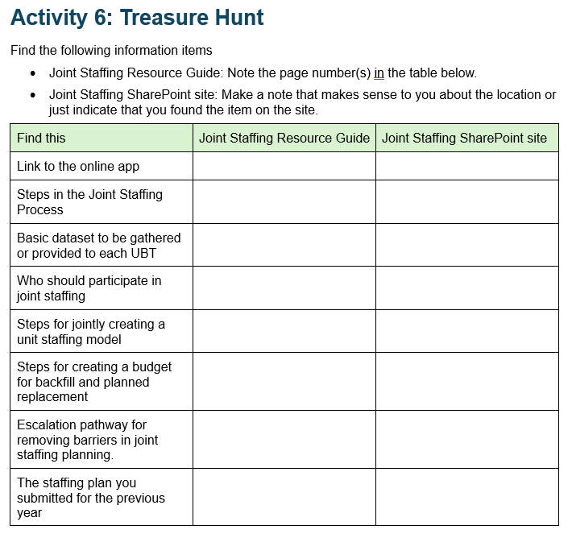
ACTIVITY 6: Treasure Hunt
Find the items in the left-hand column.
Note their location in the Joint Staffing Resource Guide or SharePoint site.
Notes:
Estimated time: 10-15 minutes
Facilitator notes:
In this activity, we provide a list of information items to find in the Joint Staffing Resource Guide and Joint Staffing SharePoint site.
BEFORE THE SESSION
Decide how you’ll provide access to the “Treasure Hunt” handout for this activity: printed copies or link to the handout in the Learner Worksheets document.
Make sure participants have access to the following:
Joint Staffing Resource Guide: Printed copy of the guide or link to the online guide: joint-staffing-resource-guide.pdf
SharePoint site: LMP Coalition Joint Staffing - Home
“Treasure Hunt” handout: https://www.lmpartnership.org/how-to-guide/joint-staffing-booster-coalition-labor-and-kp-management
INSTRUCTIONS
Provide participants with the “Treasure Hunt” handout or link and explain the activity.
Note page numbers for items found in the Resource Guide.
For items found on the SharePoint site, ask participants to simply note that as the location.
Give participants 5 minutes to work individually or in pairs to find the items in the handout, which are as follows, locations noted in bold:
Link to the online app:
To SharePoint site: https://sp-cloud.kp.org/sites/LMPCoalitionJointStaffing?mkt_tok=NzE1LVJJWi05NTkAAAGYBmPthMjGilPGUVicMkJphIb6k6YKIXwmENI1kJ8nZLnPTBL-_LBTQ7DpIr3hyQuuhx0Rw9aTHFKdXgzMeYg
Direct to online app: https://apps.powerapps.com/play/e/default-3f8a7bc4-e337-47a5-a0fc-0d512c0e05f1/a/4b624251-5f44-453f-8cdc-e8555b30b375?tenantId=3f8a7bc4-e337-47a5-a0fc-0d512c0e05f1&sourcetime=1768500106681
Steps in the Joint Staffing Process, Resource Guide, pages 5-11
Basic dataset to be gathered or provided to each UBT, Resource Guide, page 8
Who should participate in joint staffing, Resource Guide, page 13
Steps for jointly creating a unit staffing model, Resource Guide, page 26
Steps for creating a budget for backfill and planned replacement, Resource Guide, pages 28-29
Escalation pathway for removing barriers in joint staffing planning, Resource Guide, page 35
The staffing plan you submitted for the previous year: https://sp-cloud.kp.org/sites/LMPCoalitionJointStaffing?mkt_tok=NzE1LVJJWi05NTkAAAGYBmPthMjGilPGUVicMkJphIb6k6YKIXwmENI1kJ8nZLnPTBL-_LBTQ7DpIr3hyQuuhx0Rw9aTHFKdXgzMeYg

