Slide 1
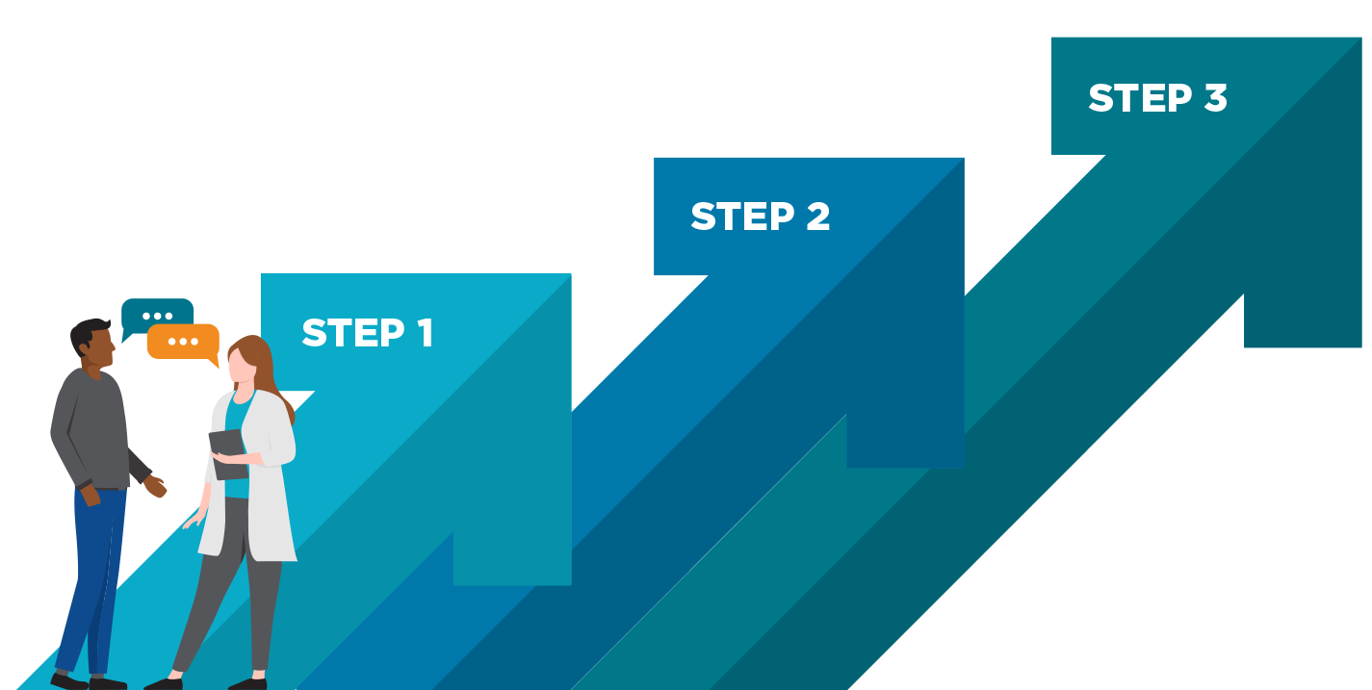
Escalation Pathway
Use this escalation process to resolve barriers during the joint staffing process. In the spirit of partnership, use this pathway only after efforts are made to resolve the barrier at the UBT level. This process does not apply to the decisions of regional budget-makers.
Notify National Staffing Oversight Committee
Issue to be resolved within
2 weeks of notification.
Notify Regional
LMP Council and
Regional Joint Staffing
Implementation Team
If issue is not resolved by either group within 2 weeks of notification, escalate issue to Step 3.
Notify UBT Sponsors
and Facility LMP Council
(where applicable)
If issue is not resolved by either group within 2 weeks of notification, escalate issue to Step 2.
NOTE: This escalation process does not preclude a local union or the Coalition of Kaiser Permanente Unions from pursuing other avenues for remedy before, during, or after this process.

