Slide 1

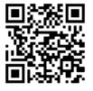

Be a lifelong learner
Build your skills and grow your career at Kaiser Permanente.

