Slide 1
The Power of Partnership
National Workforce Planning and Development Overview

Slide 2
Career mobility
Self
Assessment
Exploration
Career mobility is a journey. Kaiser Permanente has a suite of services and support to help you.
Career Management
Goal Setting
Job Search
Education & Training
Notes:
At Kaiser Permanente, career mobility is a journey. And to succeed, it takes a suite of services and support. There are degrees, certificates, skill building, career coaching, and career path information – all based in learning. Learning can include going to school, or back to school, for a degree. But it’s also about learning in shorter bursts. It’s about workshops, seminars, and certificates. It’s building technical skills. And it’s human skills such as communication, problem-solving, and resilience to keep up with changing times. Whether you’re an employee looking to advance your career or a manager building high-functioning teams, National Workforce Planning and Development can help you in your journey to prepare for the future and enhance your present.

Slide 3
Purpose
National Workforce Planning and Development enables individual and organizational success.
2005 National Agreement between KP and Partnership unions created structure for workforce development and education trusts.
With our partners, we support education and training for our workforce to build skills needed now and in the future.
External Partners
Labor and Management
National WFPD
KP Operations Leaders
Education Trust
Funds
Regional WFPD Committees
Notes:
Our work starts with the power of partnership.
It goes back to the 2005 National Agreement between Kaiser Permanente and Partnership unions. That created a structure for workforce development and education trusts.
This partnership helps ensure we design solutions that serve employees and the organization.

Slide 4
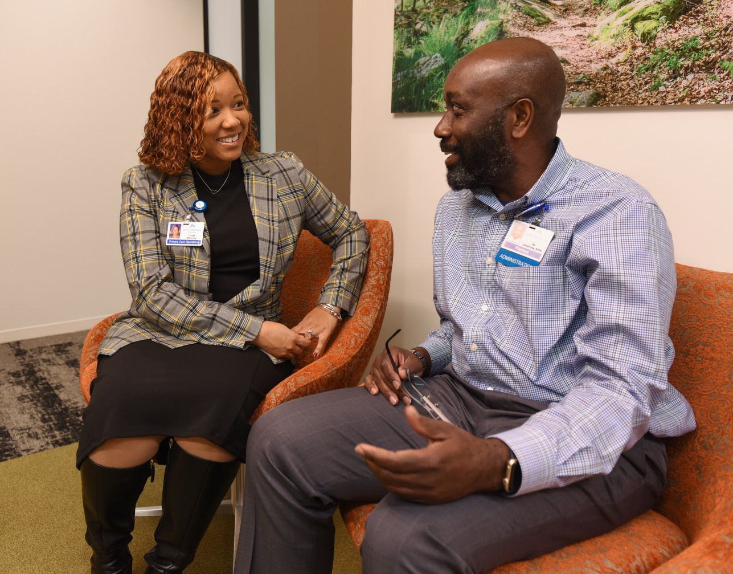
Core services
Career development
Education trust funds
Tuition reimbursement
Workforce of the Future
Notes:
In this presentation, we’ll cover our 4 core services:
• Career development • Education trust funds • Tuition reimbursement • Workforce of the Future

Slide 5
Career Development
Notes:
Transition slide

Slide 6

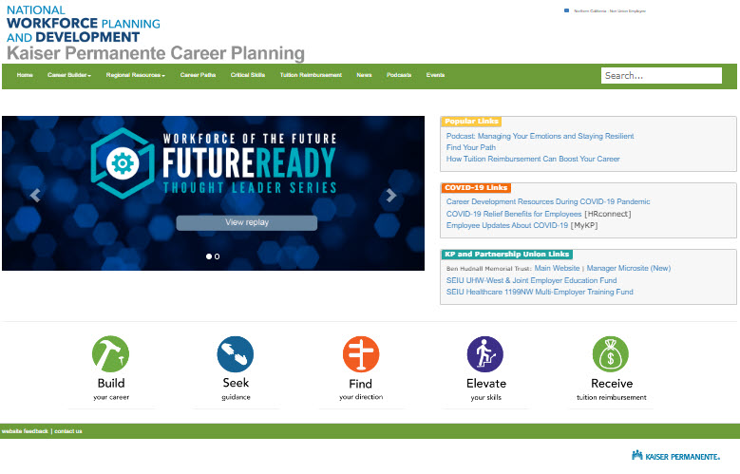
Core services
Career planning for union members and managers who want to help them.
Notes:
To support your career development, we have 3 main resources for you to navigate your career. The first is KP Career Planning. This site offers career planning for union members and managers. You can filter resources by market and union affiliation and connect with education trusts. You also can check out our workforce development podcasts, which are great! It's all there at kpcareerplanning.org.

Slide 7

Core services
Our career paths tool helps you create a personalized action plan to reach your goals.
20,000+ career path profiles
6,000+ action plans
Notes:
Another resource is PathSavvy, one of our most popular career planning pages. This interactive career paths tool helps you create a personalized action plan to reach your goals. Employees have created more than 20,000 career path profiles and 6,000 action plans. Just go to kpcareerplanning.org, click on Career Paths, and start exploring.

Slide 8

Career Resource Center
A new one-stop hub for all employees to plan their careers.
Notes:
Lastly is our Career Resource Center: This is a new one-stop hub for all Kaiser Permanente employees to plan your career. Building connections is an important part of growing your career. You can do that here by finding mentoring opportunities, community sites, or business resource groups. You can get answers to career questions. And you can use your education benefits such as tuition reimbursement and KP Learn to build in-demand skills. These resources are always there … waiting for you to take advantage of them. Just go to the Career section on HRconnect and click on Career Resource Center.

Slide 9
Education Trust Funds

Slide 10
Education trusts at a glance
The Labor Management Partnership supports 3 education trust funds:
Ben Hudnall Memorial Trust
SEIU UHW-West & Joint Employer Education Fund
SEIU Healthcare 1199NW Multi-Employer Training Fund
Union-negotiated education benefits bargained by KP, Alliance, Coalition
Address emerging needs and prepare employees for in-demand positions
Provide cost-effective training at scale
Provide equitable access to career development opportunities for diverse workforce
Notes:
The Labor Management Partnership supports 3 education trust funds.
• Ben Hudnall Memorial Trust • SEIU UHW-West & Joint Employer Education Fund • SEIU Healthcare 1199NW Multi-Employer Training Fund These union-negotiated education benefits were bargained by Kaiser Permanente, the Alliance, and the Coalition.

Slide 11
Education trusts: Programs and services
140,000+ KP employees represented by Partnership unions served
1 in 4 eligible employees use the education trusts
Popular programs and services include:
Career coaching
Financial assistance (stipends, tuition support)
Degree programs and certifications
Skill building and continuing education
Academic support
Cohort training programs
Notes:
The education trusts are amazing. They serve 140,000 KP employees represented by Partnership unions. They’re used by 1 in 4 eligible employees. They offer stipends and tuition support for degree programs and certifications. There’s also career coaching, academic support, laptop lending, and skill building.

Slide 12
Cohort training
Targeted training for:
Upskilling
Continuing education
Specialty certifications
These trainings:
Fill staffing gaps
Eliminate barriers
Address equity issues
Hundreds of cohort trainings completed
National RN-to-BSN program
Transition to practice programs
Mental Health, Imaging, Pharmacy certifications
Apprenticeships
Medical assistant
Optical dispenser
Sterile processing tech
Notes:
A key part is cohort training programs, such as apprenticeships and regional training programs. We partner on these programs that fill staffing gaps at no cost to employees while reducing backfill costs for KP. Apprenticeships combine paid on-the-job learning with classroom instruction to prepare workers for in-demand careers.

Slide 13

Employee success story
“I feel empowered. By taking steps to further educate myself and better myself, it just expands my horizons in the company to try something new, start a new career, open up a new path.”
— REGGIE WILLIAMS, SEIU-UHW, Southern California after working 20 years at Kaiser Permanente in Environmental Services, completed an apprenticeship program to become a sterile processing tech
Notes:
Here’s an example. After working 20 years for KP in Environmental Services, Reggie Williams, an SEIU-UHW member in Southern California, completed an apprenticeship to become a sterile processing tech. “I feel empowered. By taking steps to further educate myself and better myself, it just expands my horizons in the company to try something new, start a new career, open up a new path.”

Slide 14

Manager success story
“I encourage all my staff to pursue education to stay marketable and relevant. If you put the resources into your staff, it can be nothing but a win-win.”
— SOPHIA WILSON, supervisor, Health Information Management, Georgia
Notes:
Another example is Sophia Wilson. As a KP employee in Georgia, she used Ben Hudnall and tuition reimbursement to earn credentials as a coder. Now a manager, she never forgot her experience. “If you put the resources into your staff, it can be nothing but a win-win,” she says.

Slide 15
Tuition Reimbursement

Slide 16

Tuition reimbursement
Kaiser Permanente provides reimbursement to employees for completing courses.
Up to
$3,000 each year
Used by
1 in 8 eligible KP employees
Notes:
National Workforce Planning and Development also administers tuition reimbursement. Kaiser Permanente provides employees up to $3,000 each year for completing courses to continue your education, get a certificate, or earn a degree. For example, tuition reimbursement helped an admitting clerk become a psychologist. She earned not only a bachelor’s degree, but also master’s and doctoral degrees in psychology. That’s right! She earned 3 degrees while growing her career at KP, which allowed her to move from being an admitting clerk to a psychologist. You can see why employees who use workforce development programs are more likely to stay here than those who don’t. Tuition reimbursement is simple and easy to access. If you’re taking classes that cost money, tuition reimbursement will ease your load.

Slide 17
Workforce of the Future

Slide 18
Workforce of the Future initiative
Health care is transforming. Jobs are changing.
Workforce of the Future is a framework to keep up with these changes.
Here’s how:
Workforce consultants, implementation specialists, and regional labor and management leaders analyze and make sense of trends in markets
Regional committees identify training resources that will equip our workforce for the future
Community of practice shares successful practices across the enterprise
Tools such as job profiles and a manager’s guide to workforce development help to build careers and learn new ways to work
Future Ready virtual thought leader series has insights on what’s next in work and learning
Notes:
We all know that health care is changing rapidly. Kaiser Permanente and union leaders want our workforce to be ready for the changing demands of the health care industry. Our Workforce of the Future initiative aims to prepare our workforce for tomorrow’s jobs. How do we make this happen? National Workforce Planning and Development analyzes and makes sense of trends in markets. With our regional committees, we help identify training resources that will equip our workforce for the future. Our community of practice shares these successful practices across the enterprise.
We develop tools including job profiles and a manager’s guide to workforce development to help build careers and learn new ways to work.
We also host Future Ready, a virtual thought-leader series on what’s next in work and learning. Let us help you to be ready for what lies ahead.

Slide 19
Take action
What you can do:
Talk with your team about career development.
Connect with National Workforce Planning and Development consultants and project managers to find ways to build skills and support lifelong learning.
Collaborate with education trust career coaches, who can tailor trainings, provide career coaching to employees, and offer skill assessments.
Contact Regional Workforce Planning and Development Committee tri-chairs to help identify upskilling and training needs for you and your team.
Notes:
We encourage you to:
• Talk with your team about career development.
• Connect with education trust career coaches and our consultants and project managers.
• Engage with your Regional Workforce Planning and Development Committee to identify training needs for you and your team. We look forward to helping you in your journey of lifelong learning.

Slide 20
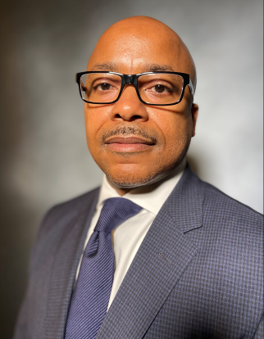


Workforce Planning and Development leadership
Lionel C. Sims, Jr., Esq.
VP, OLMP Int. Mgmt. Lead, NWFPD
Jessica Butz Director, Alliance of Health Care Unions
John Kolodny
National Coordinator, Coalition of KP Unions

Slide 21
More information
Contact: national-wfpd@kp.org
KP Career Planning: kpcareerplanning.org
Career Resource Center: sp-cloud.kp.org/sites/CareerResourceCenter
Ben Hudnall Memorial Trust: bhmt.org
SEIU UHW-West & Joint Employer Education Fund: theedfund.org
SEIU Healthcare 1199NW Multi-Employer Training Fund: healthcareerfund.org
Tuition reimbursement: kpcareerplanning.org/prd/tuition_reimbursement.php
Workforce Development Week: kpcareerplanning.org/wdw
Workforce of the Future: LMPartnership.org/workforce
Manager’s Guide to Workforce Development: LMPartnership.org/tools/manager’s-guide-workforce-development

