Slide 1



Understanding and Preventing Injuries at Work
Workplace Safety Primer – Facilitator's Guide
April 2, 2018
Notes:
Intended audience: Workplace safety co-leads, safety committee members, safety champions, and frontline workers and supervisors.
Best used: This facilitator’s guide is best used in conjunction with the Labor Management Partnership handout Workplace Safety Primer: Understanding and Preventing Injuries at Work. It will help frontline teams and safety leaders understand key principles of workplace safety and correct safety hazards by addressing root causes of injuries, identifying hazards and finding solutions.
Created March 2018

Slide 2
How to Use This Facilitator’s Guide
Companion Guide for Workplace Safety Primer: Understanding and Preventing Injuries at Work
Notes:
Facilitator Instructions
Make sure each participant has a copy of the Workplace Safety Primer: Understanding and Preventing Injuries at Work as this is meant to be a companion facilitator’s guide to that document. The primer can be downloaded at https://www.LMPartnership.org/tools/workplace-safety-primer
This facilitator’s guide is as flexible as you need it.
You can break it up into two sections — slides 2–8 focusing on the underlying causes for injuries, and slides 9–24 on solutions and resources.
There also are areas in which you can lead participants in tabletop activities (slides 7, 17 and 20).
The tabletop activities can help prompt discussion and make the learning more specific to each group’s workplace and experience.
Each activity takes about 15 minutes to read, discuss and report back; however, these can be cut or shortened if you are running short of time, or enhanced if you have more time.
Talking points are included in the notes section for each slide.
Don’t forget to add your local and regional workplace safety resources to the final slide.

Slide 3
Understanding and Preventing Injuries at Work
Agenda
Why do injuries happen?
What should we consider to prevent injuries?
What types of solutions are the best ones?
Identify actions that can be taken.
Notes:
INTRODUCTION
Facilitator: Give your name, classification and where you work (union if applicable).
Today we want to provide you with some tools to help identify hazards, come up with the best solution(s), create an action plan and follow up to completion.
We will discuss:
Why do injuries happen?
What should you consider to prevent injuries from occurring?
What types of solutions are the best ones?
What actions can be taken?
We also will summarize and leave time for questions.

Slide 4
Underlying causes

Slide 5























Why Do Injuries Happen? Josh’s Story
Direct and Underlying Causes of Injuries
DIRECT:
Josh reached into the hamper.
UNDERLYING:
Hamper too big
Not enough hampers
Understaffing
Pressure to work quickly
Notes:
Discussion – Josh’s story
Facilitator: Read Josh’s story in the Workplace Safety Primer, pages 1–2. Then we’ll talk about what we learned.
Josh, an Environmental Services worker at a hospital, had taken a soiled linen bag from the hamper from the trauma unit and was transferring it to his cart. The bag was full of wet linen so it was very heavy. Since he did not want the bag to rip when he lifted it, he took some linen off the top. He felt a sharp sting in his hand and looked down to see that a needle had stuck him in his hand.
Why did Josh get injured?
The direct cause of an injury is often identified quickly. In this case, Josh had reached into a hamper full of soiled linen, which resulted in the needle stick.
However, this explanation does not usually tell the whole story. You need to look deeper — to do some detective work to identify the underlying or root causes of an injury. You need to ask WHY at least five times to get to the answer.
Facilitator: Let’s talk about Josh’s injury. (Ask the audience the following questions):
WHY did Josh get injured?
Why did Josh reach into the bag to remove some soiled linen?
Because the bag was too heavy and he didn’t want it to rip.
Why was there a needle in the hamper?
Someone did not immediately place a used needle into a sharps container and it ended up in the linen bag.
Why was the bag so heavy?
It was full of wet linen. Maybe the hamper bags for soiled linen are too big, or maybe it had been filled beyond capacity.
Why was the hamper filled beyond capacity?
Perhaps there was only one hamper in the room.

Slide 6
Multiple Factors in Underlying Causes
Look for Underlying Causes in:
Job tasks and procedures
Work environment
Management and organization
Workforce factors
Notes:
Facilitator: Look at page 2 of the Workplace Safety Primer. There are usually multiple factors that contribute to an incident, so let’s examine all the possibilities.
(Have the audience review the underlying causes in each of the following areas):
Job Tasks and Procedures
Is the pace of work and overall workload reasonable?
Are there clear, realistic procedures for job tasks?
Are there conflicts between procedure and practice?
Are shortcuts commonly used?
Work Environment
Are work processes, equipment and tools designed properly?
Is the facility layout and space conducive to safe practices?
Is there easy access to safety and emergency equipment?
Is there regular inspection and maintenance of equipment and work areas?
Management and Organization
Is there a safety program with a commitment of resources for safety and accountability?
Does the safety culture promote systems solutions?
Do communication and reporting systems promote worker involvement?
Are staffing levels adequate?
Is scheduling realistic?
Do staff members miss breaks or meals?
Workforce Factors
Is training adequate?
Do workers suffer from fatigue or stress?
Do workers have attitudes that support safety? How do they perceive their risks?
Does staff have experience with this type of situation?

Slide 7

Tabletop Activity: Systems Approach
Break into small groups
Pick one factor from the chart on page 2 in the Workplace Safety Primer
Identify possible underlying causes of a recent injury in your facility
Report back
Notes:
Tabletop Activity – 15 minutes
Systems Approach to Finding Solutions, Workplace Safety Primer, page 2
Facilitator: Now, let’s break for a tabletop activity. We’re going to learn how to apply a systems approach to injury prevention. Here’s what you need to do…
(Read the instructions and have the audience do the following):
Look at the chart on page 2 in the Workplace Safety Primer
Break into small groups
Ask them to pick one of the four factors
Job Tasks and Procedures
Work Environment
Management and Organization
Workforce Factors
Have them discuss how they would approach an injury prevention solution using that factor in their department/workplace
Report back

Slide 8

Systems Approach to Finding Solutions
Don’t jump to conclusions
Ask the five WHYS
Dig deeper for answers
Notes:
Facilitator: It is easy to jump to conclusions on how an injury occurred (e.g., blaming the employee).
Blame undermines the ability to:
Identify systems failures and make improvements to the systems and subsystems, and in how they interact
Build safeguards and backups into the system
Speak up to address problems, errors, etc., as they arise—before they become a crisis or before the “near-miss” becomes an incident causing harm
Worker actions or behaviors are the result of the work systems.
If workers’ behaviors are “unsafe,” then recognize them as a sign or symptom of how the work “system” functions. Trying to correct the behavior of individuals (by coaching or reminders of the “safe” procedure) will not remove the systemic drivers of a behavior. People don’t go to work to get hurt or to do things the “wrong” way. They go to work to get the job done—and do it in the way the work systems lead them to.
As safety leads, we must ask WHY repeatedly and be prepared to dig deeper for our conclusions. Sometimes you have to ask FIVE times to get to the bottom of why something occurred and how can can be corrected.
Keep going through different factors to get to the answer.

Slide 9
Finding the right solution

Slide 10

Focus on Solutions: Shelly’s Story
Notes:
Facilitator: Read Shelly’s story and discuss: Workplace Safety Primer, pages 3–4
Shelly is a registered nurse at a medical center. One afternoon her co-worker called her over and asked for her help moving a patient to an upright position on the bed. Shelly went to help, and as she twisted slightly while lifting the patient, she felt something pop in her back. Later, when the pain intensified, she went to see her doctor and found out she had injured a disk.
Facilitator: We can have a chuckle at this cartoon, but in reality, injuring your back is no laughing matter. Just as understanding the root causes of an injury involves a systems approach, so does coming up with solutions. In Josh’s example, the solutions should involve ways to make the hamper bags less full or heavy.
Let’s talk about Shelly’s injury. (Ask audience the following questions):
Why did this injury occur?
Direct cause: Shelly was lifting a patient, and in doing so, twisted slightly.
Underlying cause: Common practice is to boost patients without lift assist equipment. Perhaps there wasn’t a sliding sheet within easy access or a ceiling lift in the room.
What solutions could make Shelly’s work environment safer?
In this case, Shelly should have received training on safe lifting practices, including proper body mechanics. However, even if she did this with ideal body mechanics she could still be injured, because this lift is inherently unsafe. A better solution is to use a ceiling lift or sliding sheet to aid with boosting a patient. These lifting aids reduce the force needed to boost the patient, reducing the risk to the worker’s body.

Slide 11
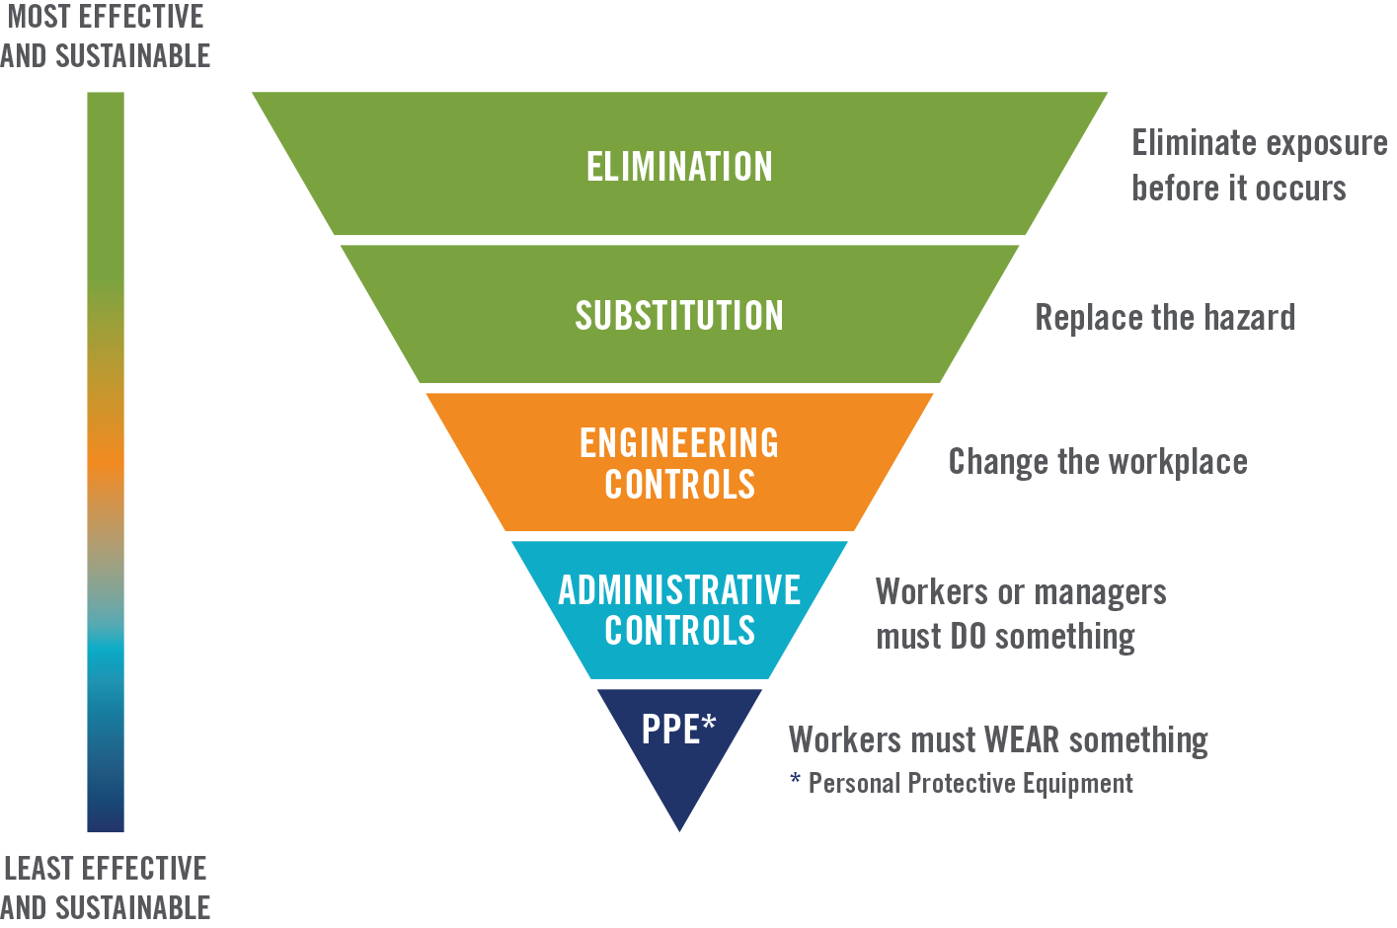
Reducing Risks: Hierarchy of Controls
Notes:
Facilitator: Take a few minutes to read the Workplace Safety Primer, pages 4–6, on the Hierarchy of Controls.
The idea behind this hierarchy is that the control methods at the top of graphic are potentially more effective and protective than those at the bottom. Following this hierarchy normally leads to the implementation of inherently safer systems, where the risk of illness or injury has been reduced substantially.
Now, let’s go the next slide. (Turn to next slide).
Elimination and Substitution
Elimination and substitution, while most effective at reducing hazards, also tend to be the most difficult to implement in an existing process. If the process is still at the design or development stage, elimination and substitution of hazards may be inexpensive and simple to implement. For an existing process, major changes in equipment and procedures may be required to eliminate or substitute for a hazard.
Engineering Controls
Engineering controls are favored over administrative and personal protective equipment (PPE) for controlling existing worker exposures in the workplace because they are designed to remove the hazard at the source, before it comes in contact with the worker. Well-designed engineering controls can be highly effective in protecting workers, and typically are independent of worker interactions to provide this high level of protection. The initial cost of engineering controls can be higher than the cost of administrative controls or PPE, but over the longer term, operating costs are frequently lower, and in some instances, can provide a cost savings in other areas of the process.
Administrative Controls/Worker Awareness and PPE
Administrative controls and PPE are frequently used with existing processes where hazards are not particularly well controlled. Administrative controls and PPE programs may be relatively inexpensive to establish but, over the long term, can be very costly to sustain. These methods for protecting workers also have proven to be less effective than other measures, requiring significant effort by the affected workers.
Adapted from the www.cdc.gov/niosh/topics/hierarchy/.

Slide 12
Finding Solutions
Work toward solutions
that control the hazard,
not the worker.
Notes:
Facilitator: When we eliminate a hazard, no one is exposed to it. We can work down the controls to find solutions, but we should always keep in mind that keeping workers and patients safe is our priority.
Using the Hierarchy of Controls approach, we can find solutions that:
Eliminate the opportunity for errors
Make it hard to do the wrong thing
Make it easy to do the right thing
Let’s review each of these controls. (Turn to next slide).

Slide 13
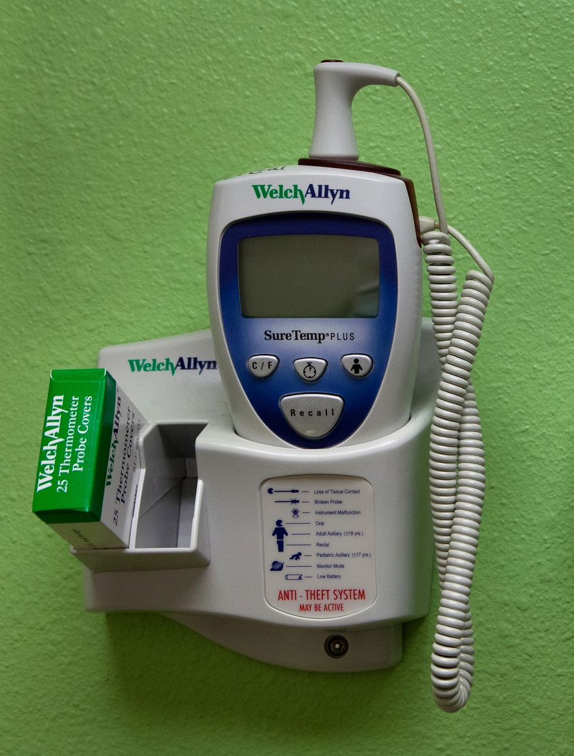

Elimination and Substitution
Thermometers without mercury
Nonlatex gloves
Notes:
Instructions: Review the following concepts, then hold a discussion using the questions below.
Facilitator: Look at the bottom of page 4 in the Workplace Safety Primer. Let’s review elimination and substitution….
Elimination
The best way to protect employees is to remove/eliminate the hazards from the work environment altogether. Then you directly address the hazard and do not depend on employees’ actions to be effective.
Examples include:
Leaky pipe fixed so floor does not have wet spots
Asbestos removed from a facility
Facility built without asbestos
Lead-free paint and plumbing
Medical equipment without latex or PVC
Thermometers without mercury
Substitution
Another way to remove the hazard is to replace it with a safer alternative. Examples include:
Substitute safer sterilizing process for ethylene oxide
Use less toxic cleaning products to clean office areas
Use gloves made with nonlatex material instead of latex
DISCUSSION
Can you name any others?
Can you provide an example of something else you have eliminated or substituted in your workplace?

Slide 14
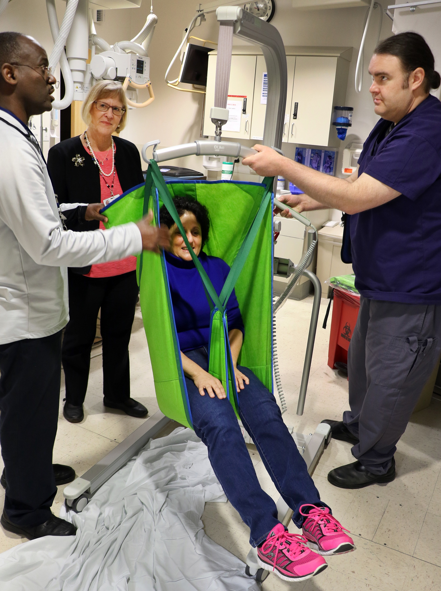

Engineering Controls
Specialized patient lift equipment
Telephone headsets
Notes:
Instructions: Review the following concepts, then hold a discussion using the questions below.
Facilitator: Turn to page 5 of the Workplace Safety Primer. Let’s look at engineering controls…
Engineering controls remove the hazard at the source so that it is kept away from the employees. They directly address the hazard and do not depend as much on employees’ actions to be effective.
Examples include:
Local exhaust ventilation where infectious agents or toxic materials are found
Using needles with a safety mechanism that is triggered automatically
Using “no-lift” hampers for linen
Sharps disposal containers
Equipment used to help lift, mobilize, position or transfer a patient
Lead-shielded walls surrounding radiation-producing equipment
Carts for transporting supplies
Powered cart/truck for moving heavy items
Beds that change height and position at the touch of a button
Powered transport chairs
Nonskid mats or flooring in areas that can be wet
Microfiber mop
Telephone headset
Adjustable-height computer workstation
DISCUSSION
Can you name any others?
Can you provide an example of an engineering control in your facility?

Slide 15
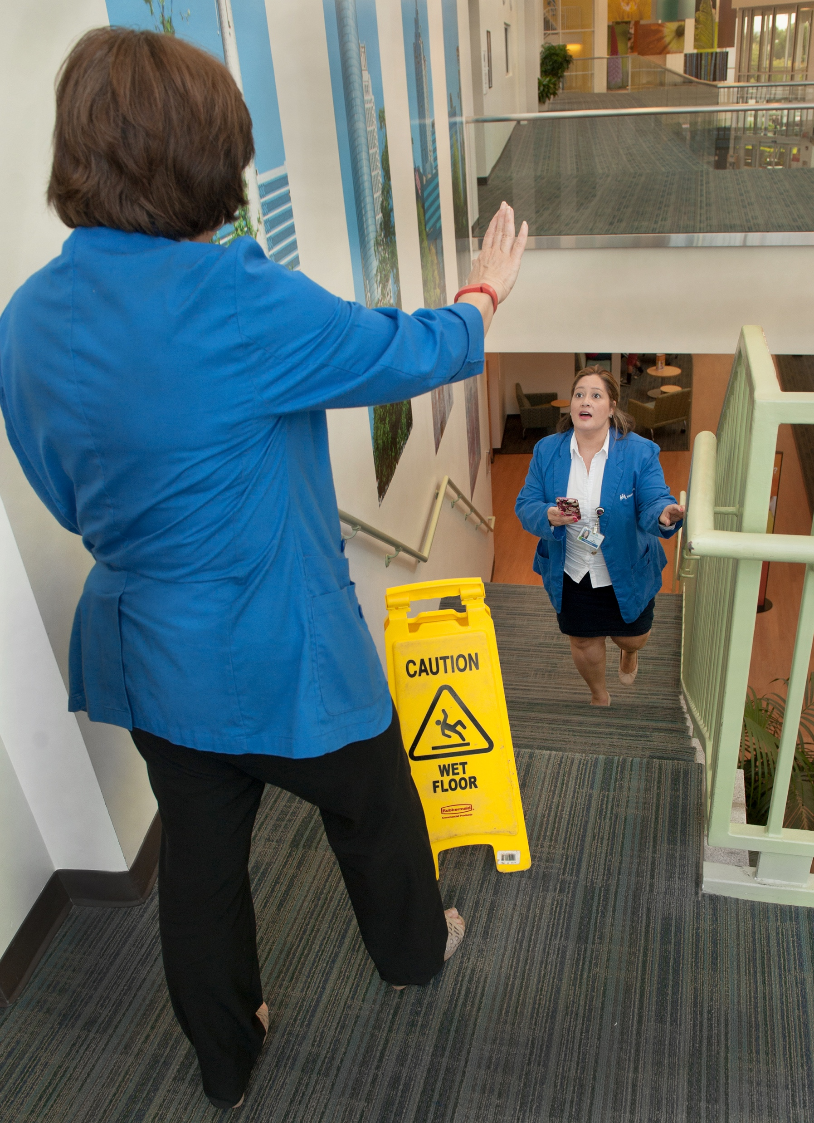

Administrative Controls – Worker Awareness and Training
Warning signs
Worker awareness training
Notes:
Instructions: Review the following concepts, then hold a discussion using the questions below.
Facilitator: Now, let’s discuss administrative controls at the bottom of page 5 of the Workplace Safety Primer.
When a hazard cannot be eliminated or engineered out, another option is to change work procedures and safety rules to limit employees’ exposure to the danger. These often are called administrative controls.
Examples include:
Assigning enough people to do the job safely
Providing worker training
Rotating employees between hazardous tasks and nonhazardous tasks
Having an established way to send a signal when there is a problem (for example, a panic button)
Having a policy that tells workers to use lift equipment to lift patients
Revising procedures for a task to include the steps needed to do it safely
Posting a quick-reference card near a piece of equipment to remind people how to use it safely
Installing warning signs, lights and alarms
The least effective control—with the most individual action needed—is worker awareness and more training. While it is important for all of us to be updated on the newest procedures and processes—without attention given to the other controls—we are not fixing the problem.
Warnings, procedures and trainings are important, but they don’t separate workers from the hazard, they just remind us of the hazard.
DISCUSSION
Can you provide an example of a workplace safety policy or procedure?

Slide 16

Personal Protective Equipment (PPE)
Face shield and protective clothing
Notes:
Instructions: Review the following concepts, then hold a discussion using the questions below.
Facilitator: Let’s talk about personal protective equipment, or PPE. Turn to page 6 in the Workplace Safety Primer.
Personal protective equipment, or PPE, is worn to help shield people from exposure to a hazard. It is less protective than the other options because it doesn’t get rid of or control the hazard itself. Instead, it places an imperfect barrier between the hazard and the worker.
Examples include:
Gloves (exam, surgical, cut-resistant, rubber)
Respirators (N95, PAPR)
Lead apron
Protective clothing (gown, shoe cover, head and neck cover, water-resistant or waterproof apron or gown)
Face shield
Eye protection
DISCUSSION
Can you provide examples of barriers or challenges to using PPE in your area?
How can we solve those?

Slide 17
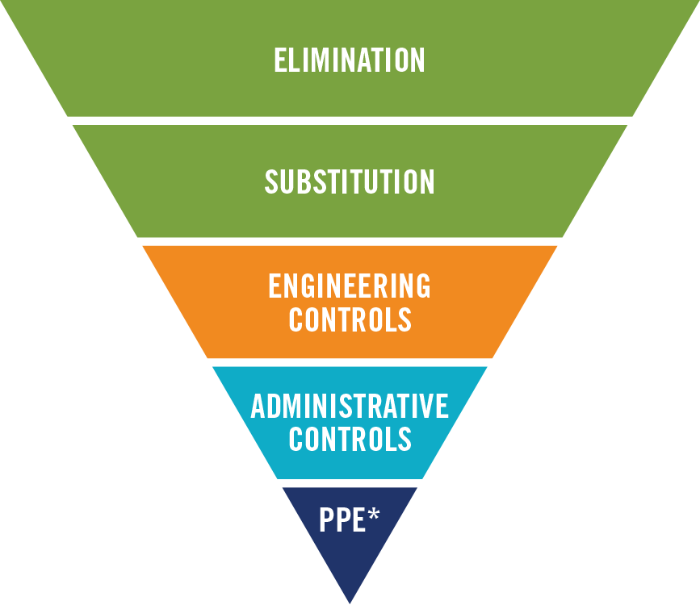
Tabletop Activity: Hierarchy of Controls
How can you use the Hierarchy of Controls to find effective solutions to prevent injuries?
Provide an example from your workplace
Discuss
*Personal Protective Equipment
Notes:
Tabletop Activity – 15 minutes
Hierarchy of Controls
Facilitator: Now, let’s pause for a tabletop activity. We’re going to break into small groups and discuss how the Hierarchy of Controls can help us find effective solutions to prevent injuries from happening.
(Have the audience do the following):
Break into small groups
Have them identify an injury risk in their own department
Discuss how to eliminate or reduce that risk using the Hierarchy of Controls on page 4 of the Workplace Safety Primer
Report back
Facilitator: Remember, various methods can be used to protect workers. These are called hazard controls, and not all controls are equally effective.
We call this the “hierarchy of controls.” Often a combination of methods offers the best protection.

Slide 18
Common hazards

Slide 19
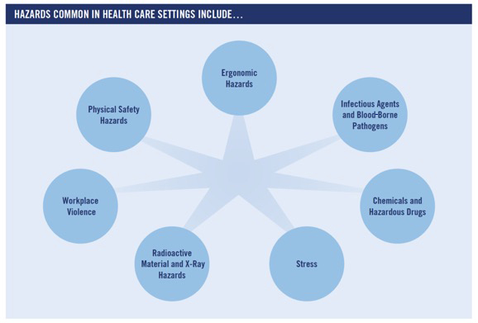
Common Hazards in Health Care
Notes:
Facilitator: Let’s talk about the common hazards in health care. Turn to page 7 in the Workplace Safety Primer.
Health care workers face a number of serious safety and health hazards. Many of them are obvious, like sharp objects, slippery floors and heavy bags or boxes.
Other hazards, such as repetitive movements and chemical exposure, may be less obvious.
Sometimes it is hard to tell whether repetitive movements on the job caused the pain in your arms, hands or back. It also may be hard to tell whether the chemicals at work caused an illness.
It is important to be aware of the variety of hazards to look for on the job.
Now, let’s look at each hazard, starting on page 8 of the Workplace Safety Primer.
(Have the audience review the following):
Ergonomic Hazards
Infectious Agents and Blood-Borne Pathogens
Chemicals and Hazardous Drugs
Stress
Radioactive Material and X-Ray Hazards
Workplace Violence
Physical Safety Hazards

Slide 20
Tabletop Activity: Finding Solutions
Break into groups
Choose a common hazard in your workplace
Discuss ways you can prevent injuries by using the Hierarchy of Controls
Report back
Notes:
Tabletop Activity – 15 minutes
Finding Solutions
Facilitator: Let’s break for a tabletop activity. I’m going to read the instructions, then I’ll give you an example.
(Read instructions):
Break into groups
Pick one common hazard in your facility and discuss how you might approach an injury investigation using the Hierarchy of Controls you just learned about on page 4 of the Workplace Safety Primer.
Ask: what do other workers need to be aware of if they wander into another area they aren’t familiar with?
Report back to group
Facilitator: Here’s my example:
Ergonomic hazards are common for office workers because they spend a lot of time at their desk, working on computers.
Looking at the Hierarchy of Controls, the best way to avoid injury is by applying administrative controls.
We could protect workers from injury by adjusting their work stations and scheduling an ergonomic evaluation, improved (or different) equipment to reduce ergonomic risk, scheduled rest breaks, rotate work tasks during the day to reduce exposure to the same ergonomic risk all day.
Now it’s your turn!

Slide 21
Review
Direct and Underlying Causes
Systems Approach
Hierarchy of Controls
Common Hazards
Notes:
Facilitator Instructions
Review the BIG ideas from the training:
Direct and Underlying Causes
Systems Approach
Hierarchy of Controls
Common Hazards
Encourage participants to keep the Workplace Safety Primer handy to help review when they approach injury prevention in their facility.

Slide 22
Understanding and Preventing Injuries
Questions?
Comments?
Notes:
Questions or comments?

Slide 23
Online Resources
Visit LMPartnership.org for these resources:
Workplace Safety Primer: Understanding and Preventing Injuries at Work
How-To Guide: Make the Workplace Safer
Make the Workplace Safer Action Guide
Notes:
Visit LMPartnership.org and click on “LMP Focus Areas,” and you will find safety tools to download and share with your teams.
Download the Workplace Safety Primer on LMPartnership.org.

Slide 24
Regional Resources
Southern California WPS UBT Resources SharePoint
Safety action plans
Safety tracking log
Hazard risk walk
Other WPS tools and documents
https://sites.sp.kp.org/teams/sclmp/WPS/UBTResources/SitePages/Home.aspx
Notes:
Add your regional and local resources; include your local resources’ names and contact information.

